Slide 1
Reviewing Artists 14th century

Slide 2
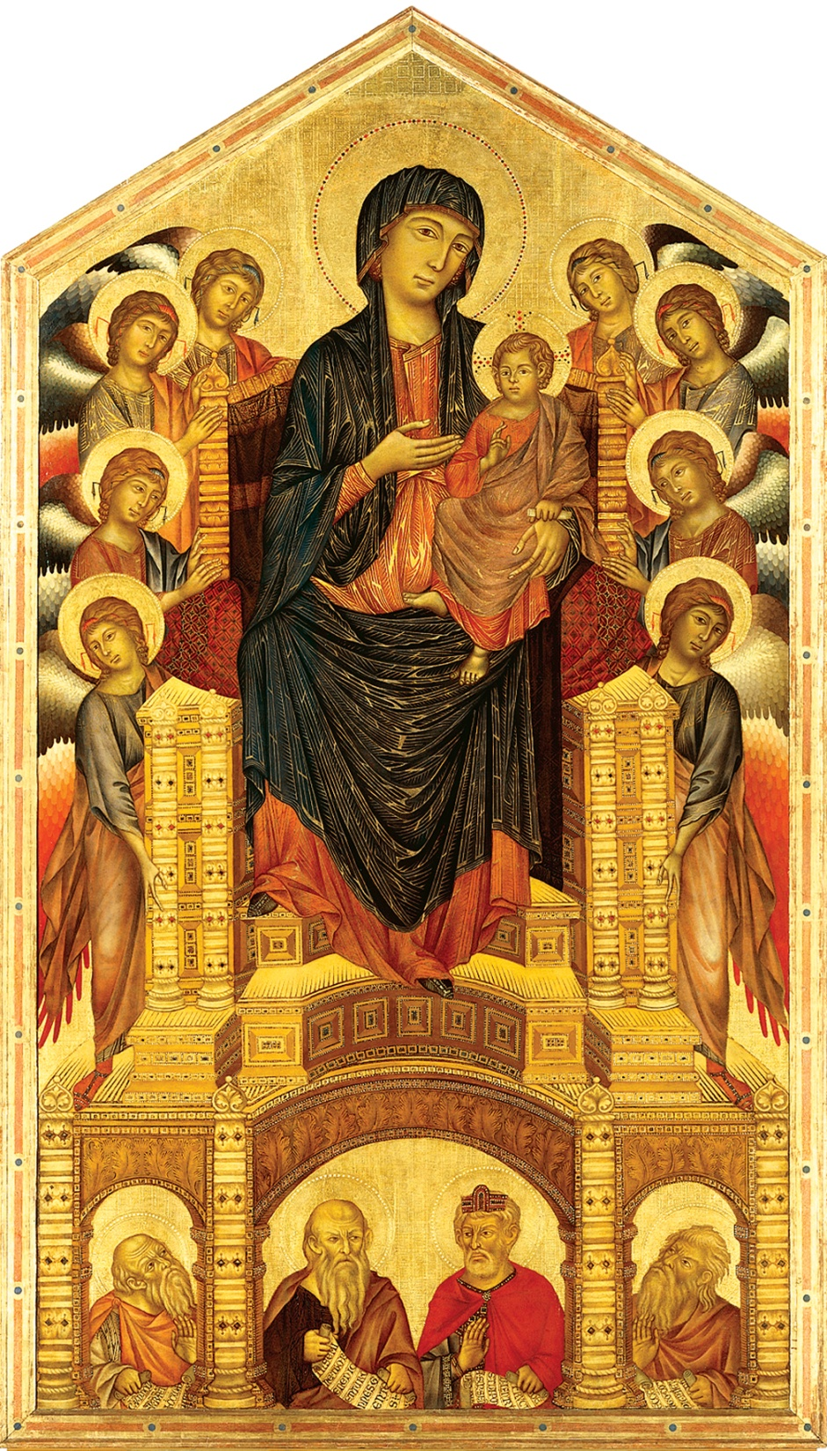
Cimabue
Madonna Entrhoned with Angels and Prophets

Slide 3
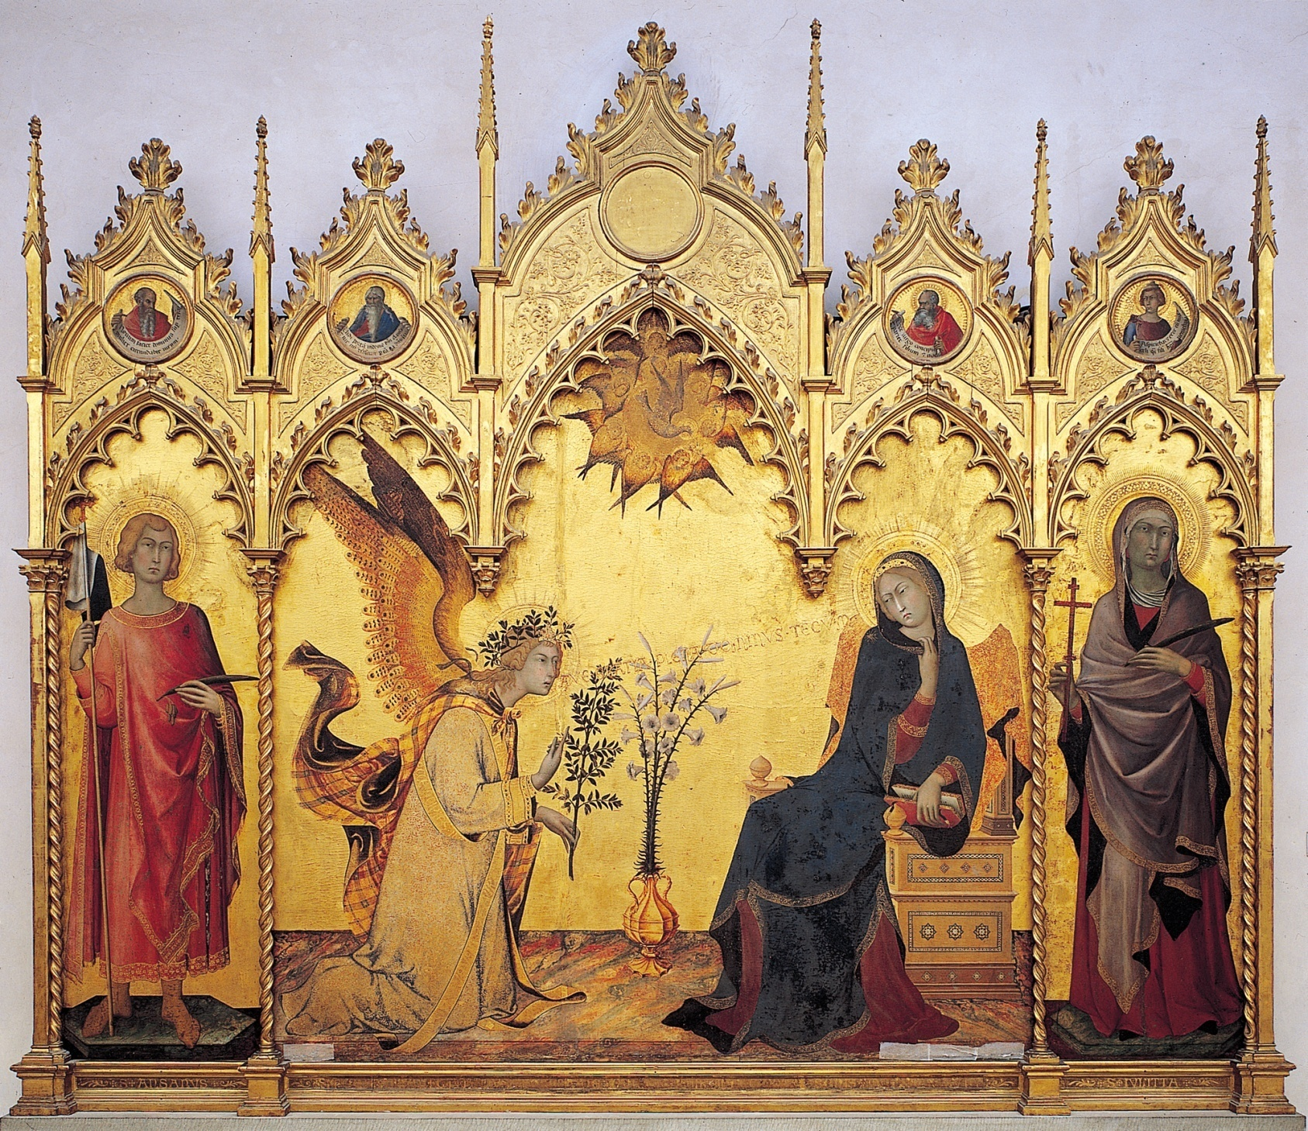
Martini
Annunciation

Slide 4
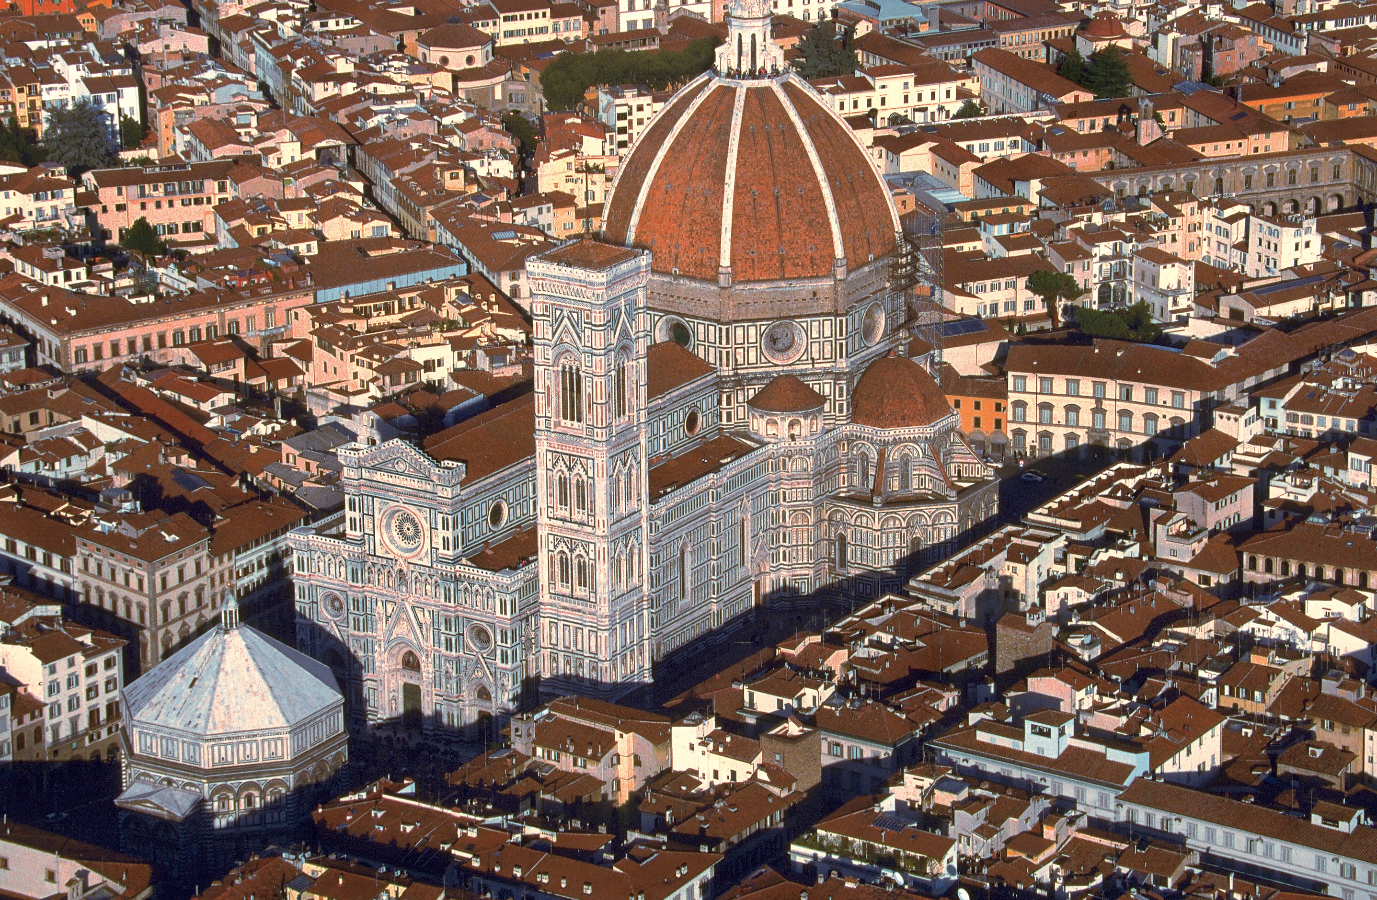
Cambio
Florence Cathedral

Slide 5
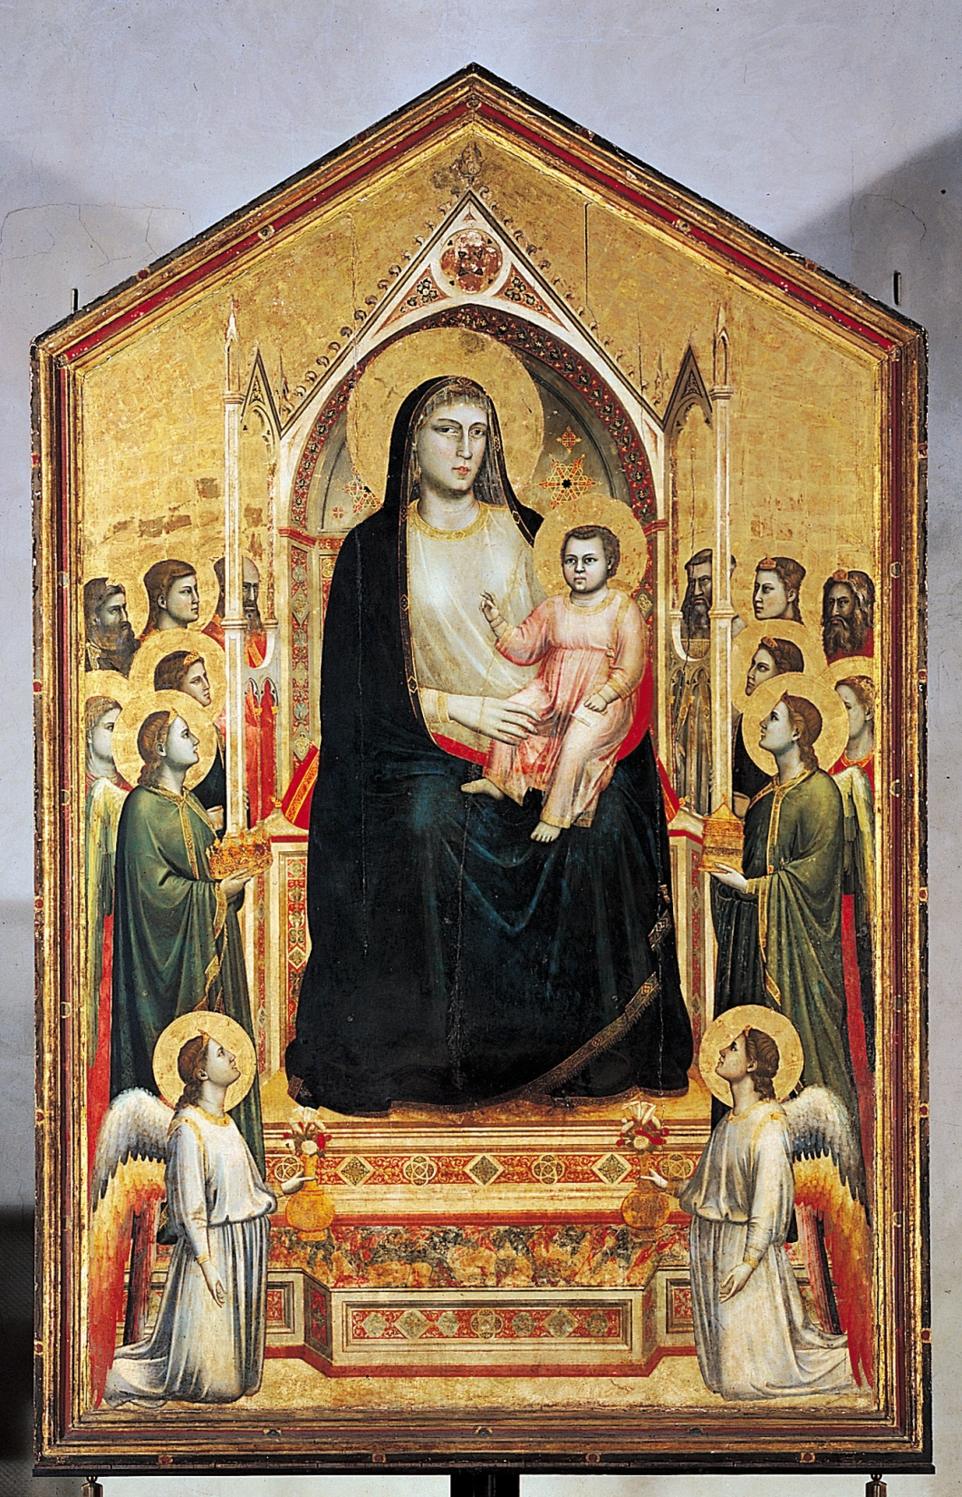
Giotto
Madonna Entrhoned with Angels

Slide 6
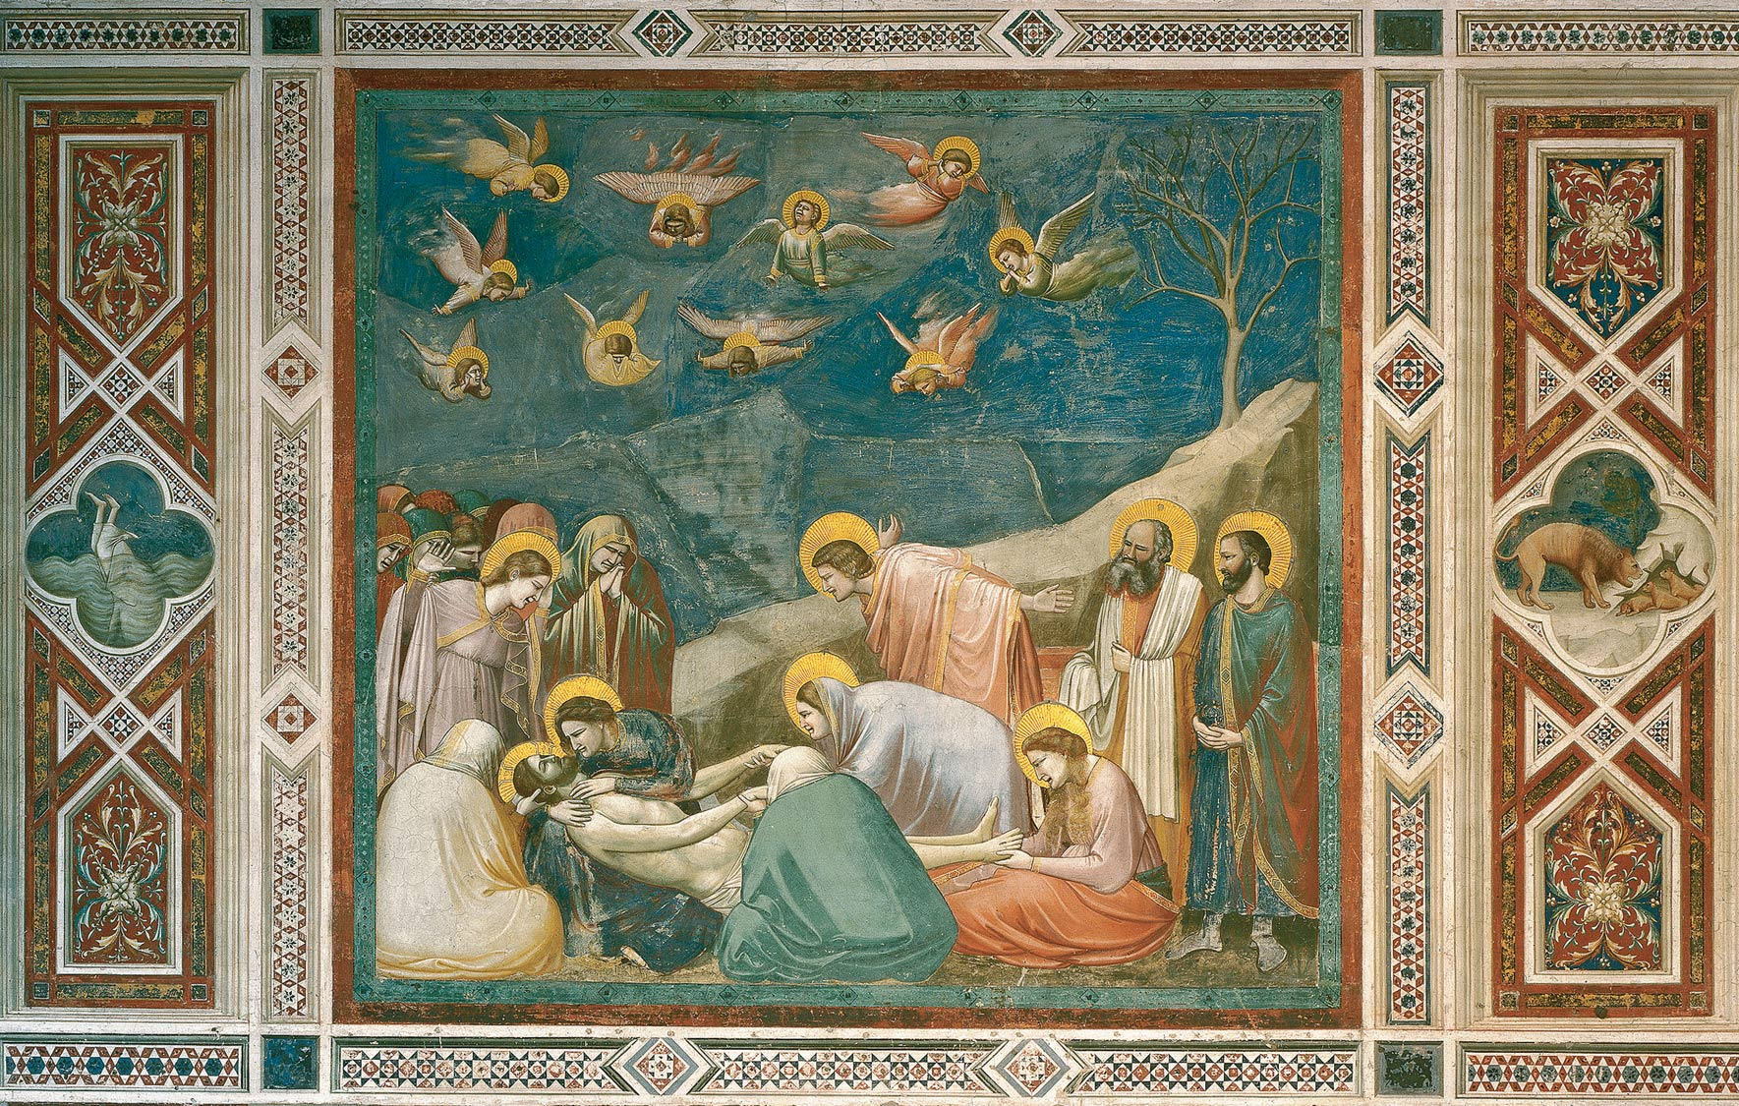
Giotto
Lamentation

Slide 7
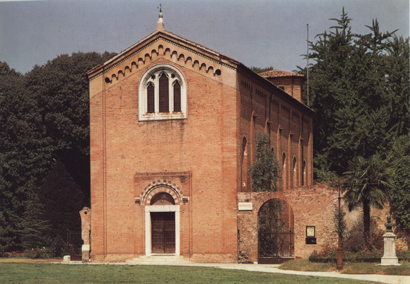
Giotto
Arena Chapel

Slide 8
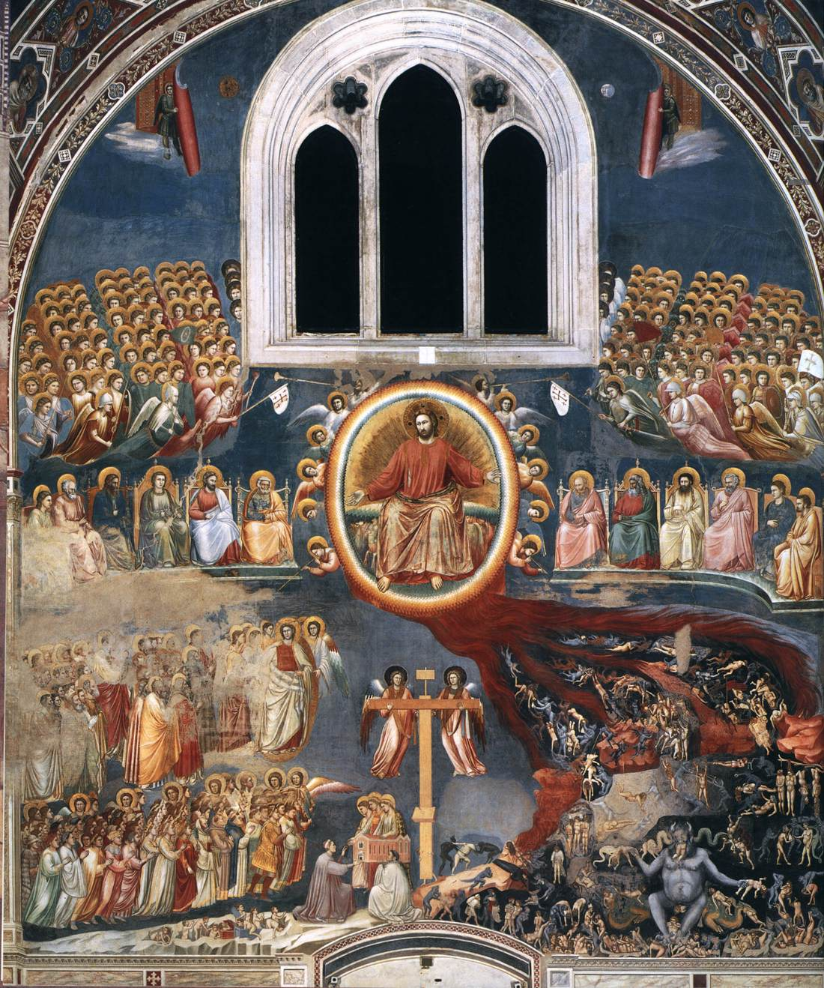
Giotto
Last
Judgment

Slide 9
Reviewing Artists! 15th century

Slide 10
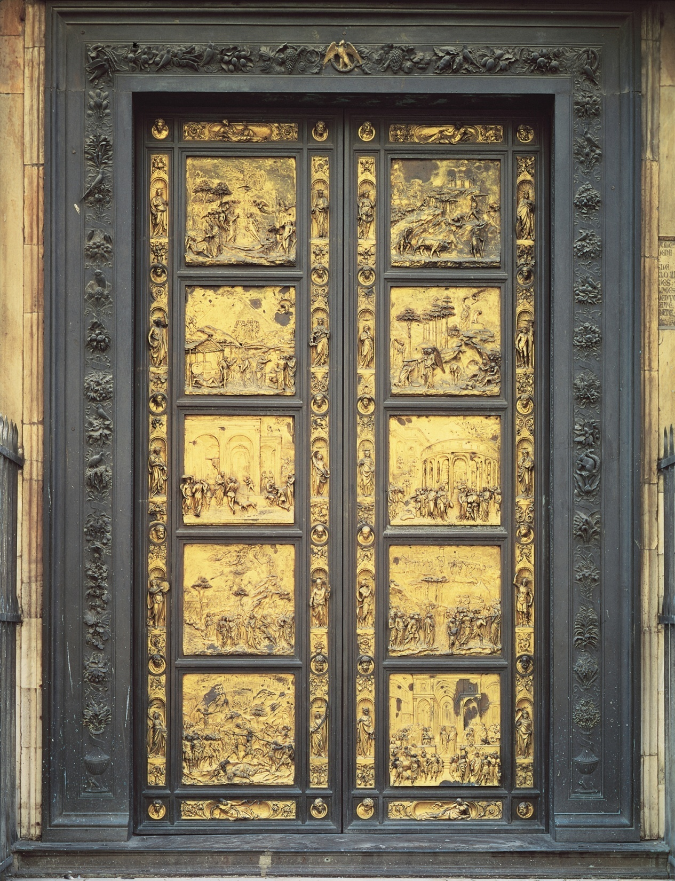
Ghiberti
Gates of Paradise

Slide 11
Brunelleschi
Dome of the Florence Cathedral

Slide 12
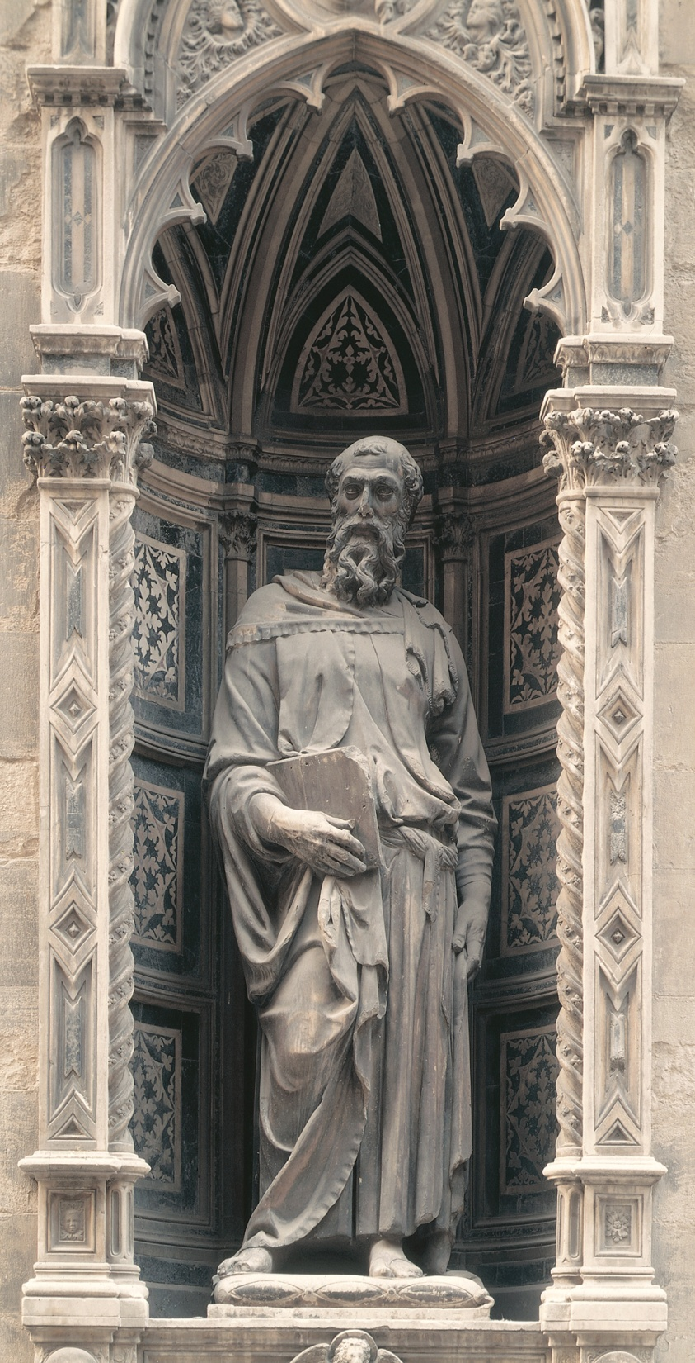
Donatello
St. Mark

Slide 13
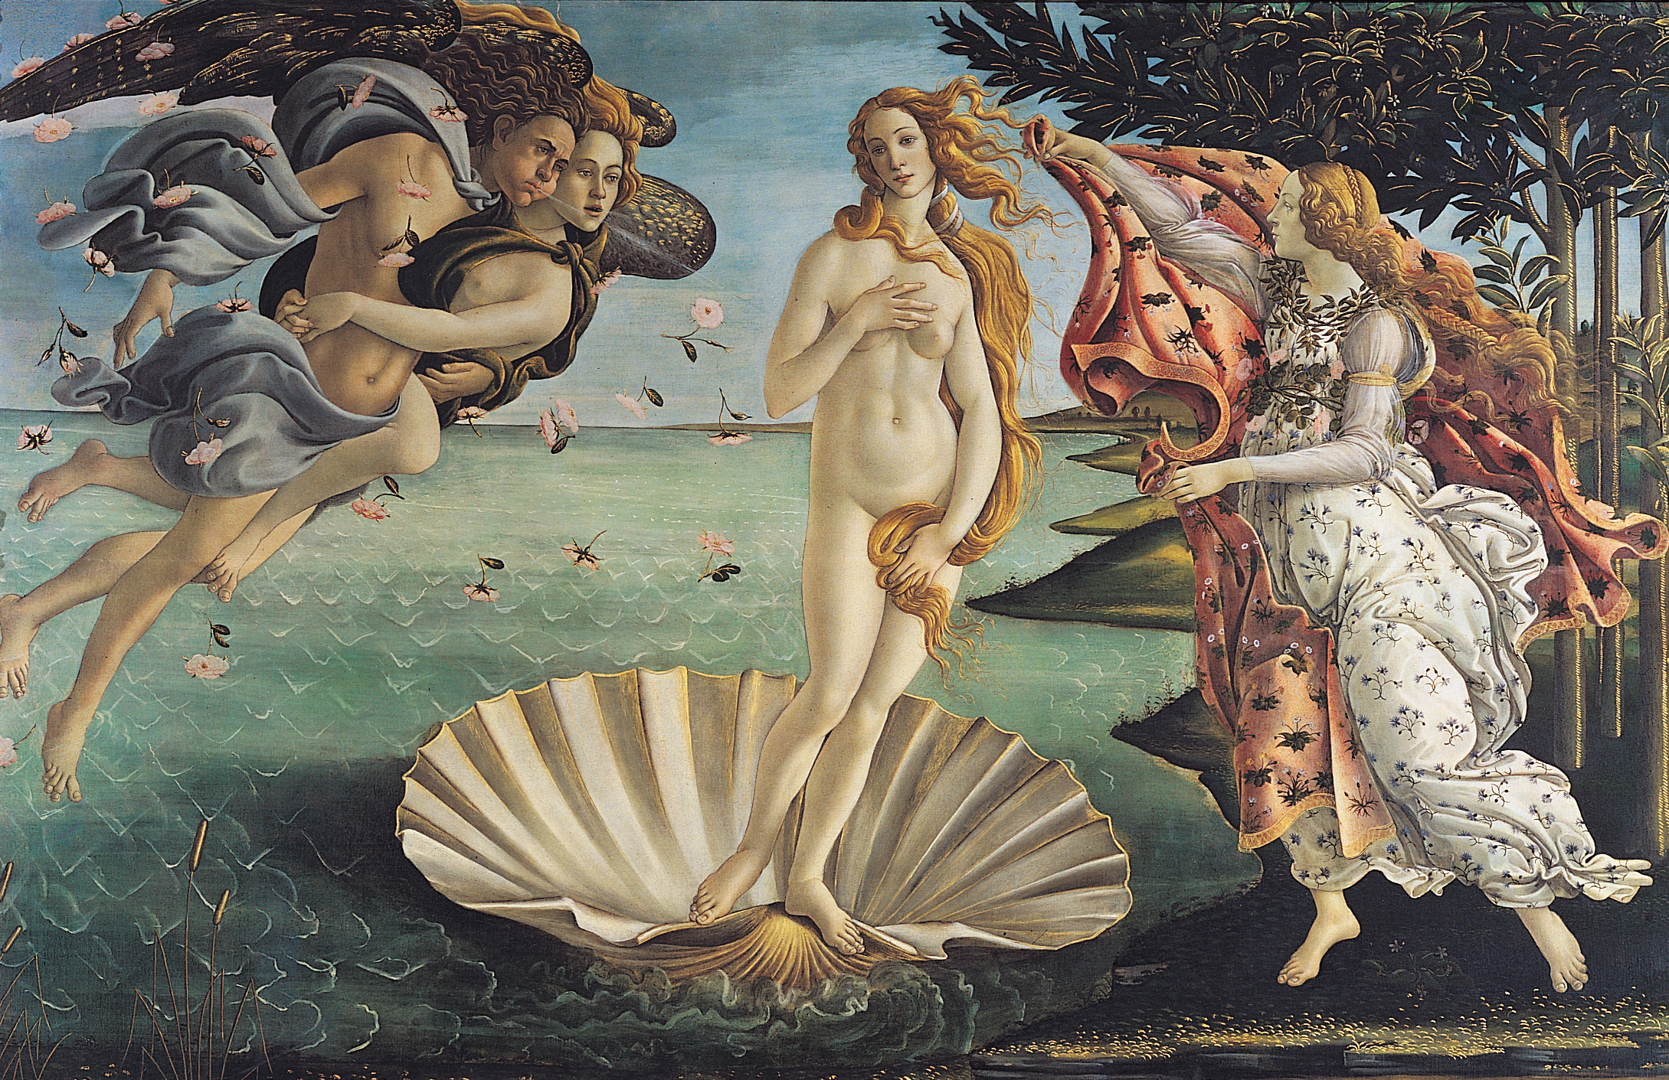
Botticelli
Birth of Venus

Slide 14
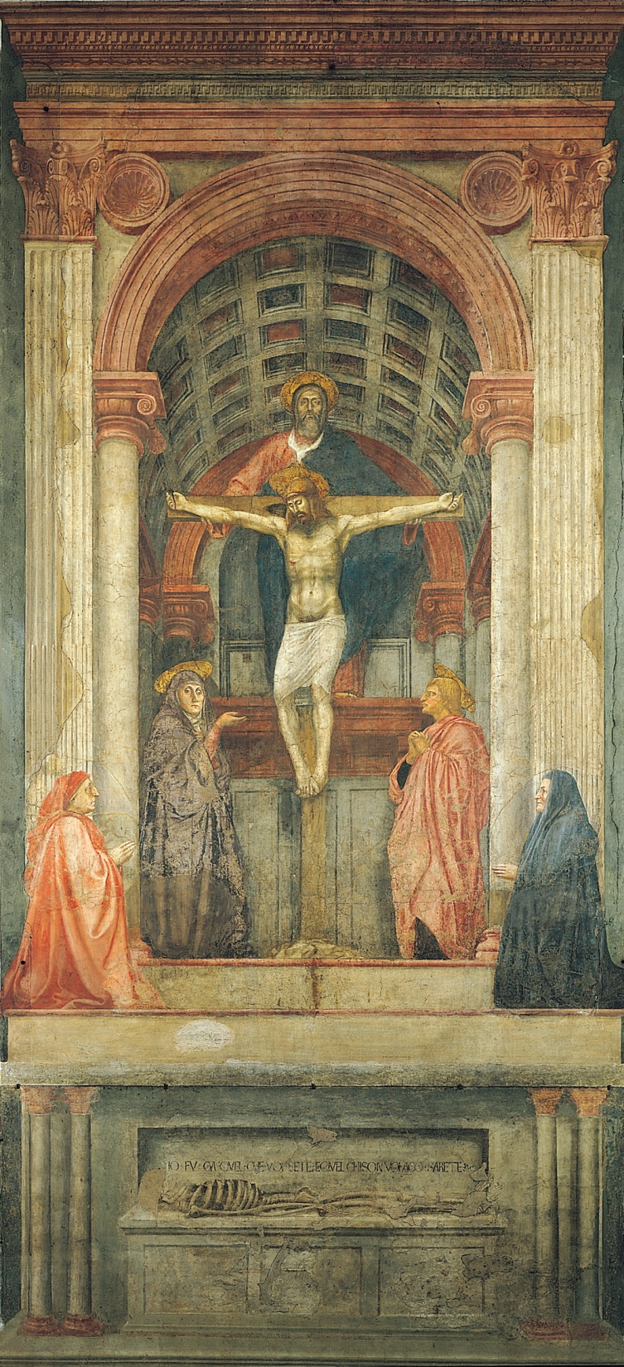
Masaccio
Holy Trinity

Slide 15
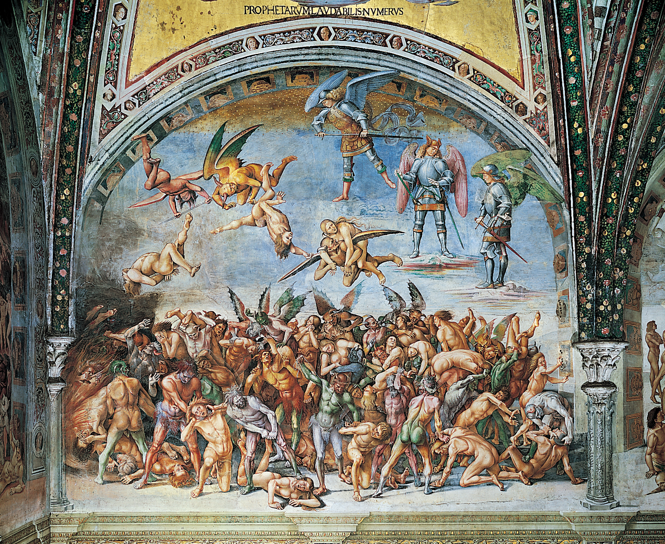
Signorelli
Damned Cast into Hell

Slide 16
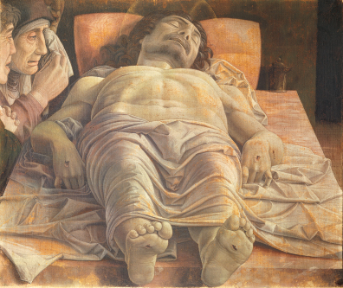
Mantegna
Dead Christ

Slide 17
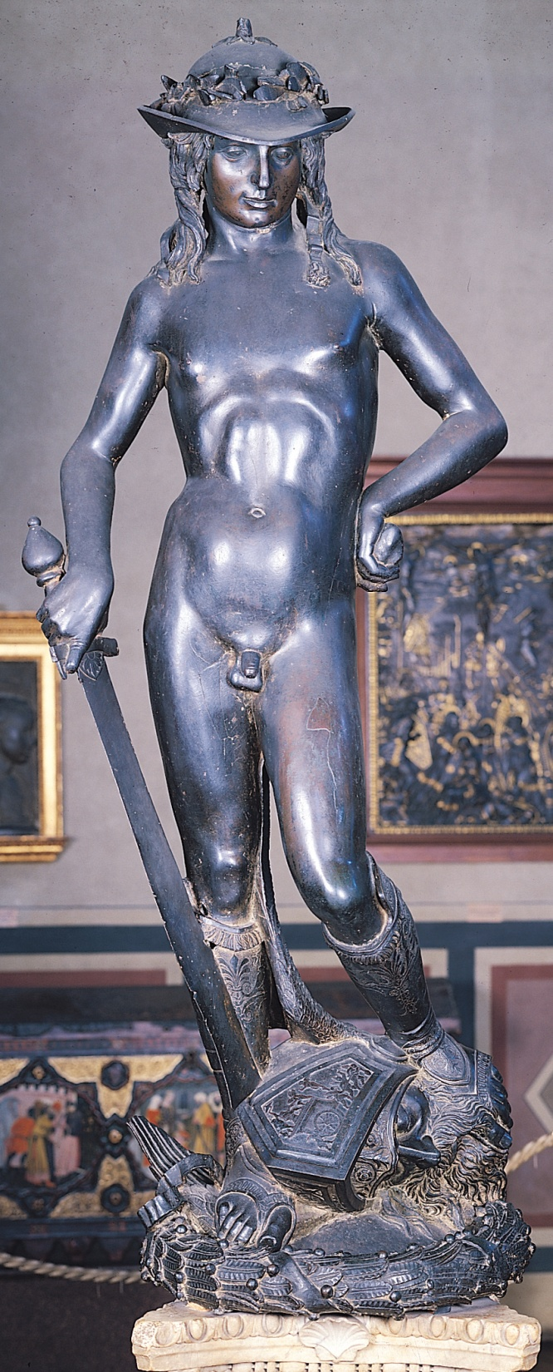
Donatello
David

Slide 18
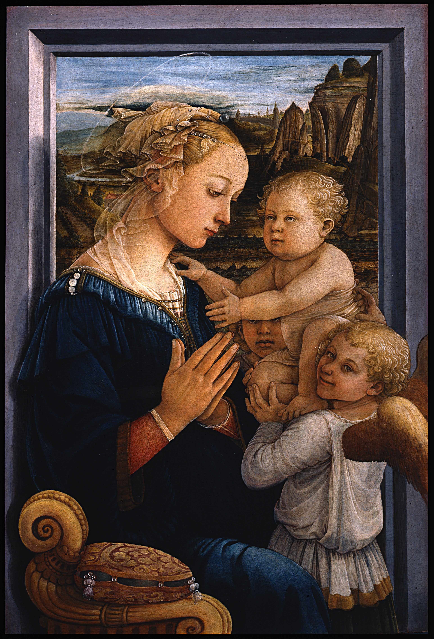
Lippi
Madonna and Child with Two Angels

Slide 19
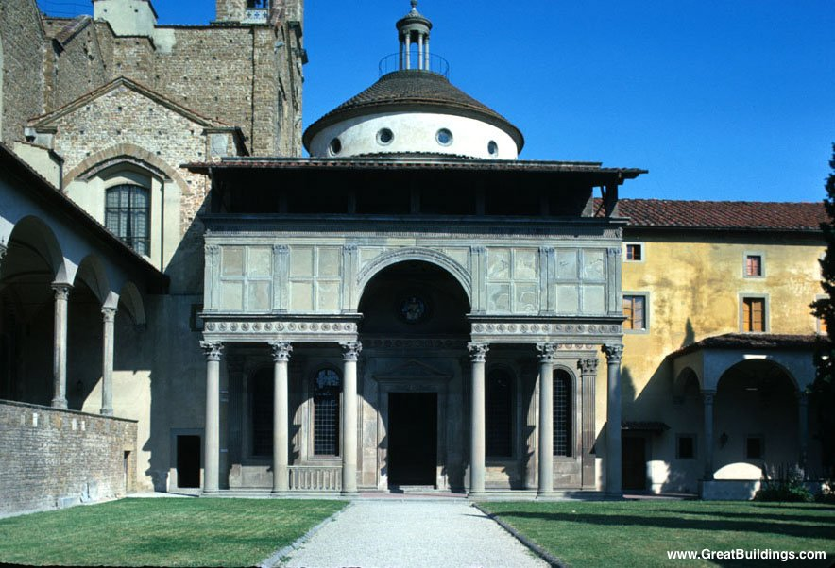
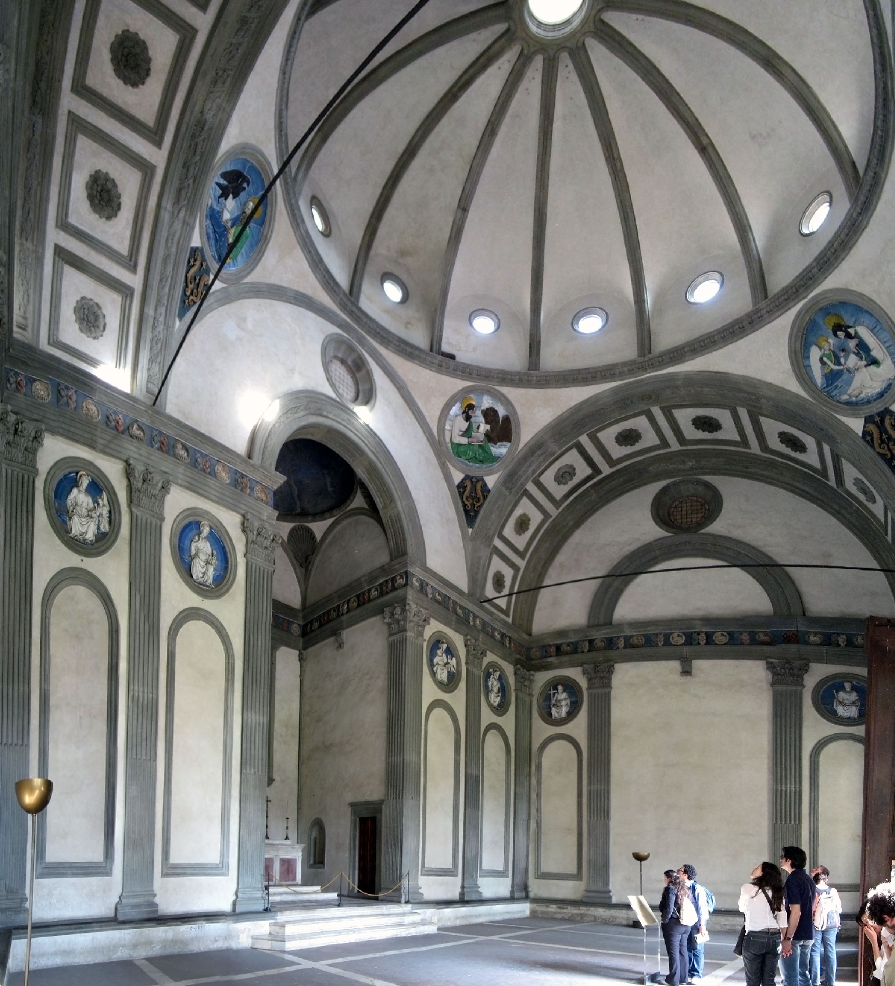
Brunelleschi
Pazzi Chapel

Slide 20
Mixed up!

Slide 21
Martini
Annunciation

Slide 22
Cambio
Florence Cathedral

Slide 23
Ghiberti
Gates of Paradise

Slide 24
Brunelleschi
Dome of the Florence Cathedral

Slide 25
Donatello
St. Mark

Slide 26
Cimabue
Madonna Entrhoned with Angels and Prophets

Slide 27
Lippi
Madonna and Child with Two Angels

Slide 28
Botticelli
Birth of Venus

Slide 29
Signorelli
Damned Cast into Hell

Slide 30
Donatello
David

Slide 31
Giotto
Lamentation

Slide 32
Cimabue
Madonna Entrhoned with Angels and Prophets

Slide 33
Botticelli
Birth of Venus

Slide 34
Mantegna
Dead Christ

Slide 35
Giotto
Last
Judgment

Slide 36
Masaccio
Holy Trinity

Slide 37
Giotto
Arena Chapel

Slide 38
Signorelli
Damned Cast into Hell

Slide 39
Brunelleschi
Dome of the Florence Cathedral

Slide 40
Giotto
Arena Chapel

Slide 41
Brunelleschi
Pazzi Chapel

Slide 42
Martini
Annunciation

Slide 43
Lippi
Madonna and Child with Two Angels

Slide 44
Donatello
St. Mark

Slide 45
Cambio
Florence Cathedral

Slide 46
Mantegna
Dead Christ

Slide 47
Giotto
Lamentation

Slide 48
Giotto
Last
Judgment

Slide 49
Giotto
Madonna Entrhoned with Angels

Slide 50
Ghiberti
Gates of Paradise

Slide 51
Brunelleschi
Pazzi Chapel

Slide 52
Masaccio
Holy Trinity

Slide 53
Giotto
Madonna Entrhoned with Angels

Slide 54
Donatello
David

Slide 55
Martini
Annunciation

Slide 56
Cambio
Florence Cathedral

Slide 57
Ghiberti
Gates of Paradise

Slide 58
Brunelleschi
Dome of the Florence Cathedral

Slide 59
Donatello
St. Mark

Slide 60
Cimabue
Madonna Entrhoned with Angels and Prophets

Slide 61
Lippi
Madonna and Child with Two Angels

Slide 62
Botticelli
Birth of Venus

Slide 63
Signorelli
Damned Cast into Hell

Slide 64
Donatello
David

Slide 65
Giotto
Lamentation

Slide 66
Cimabue
Madonna Entrhoned with Angels and Prophets

Slide 67
Botticelli
Birth of Venus

Slide 68
Mantegna
Dead Christ

Slide 69
Giotto
Last
Judgment

Slide 70
Masaccio
Holy Trinity

Slide 71
Giotto
Arena Chapel

Slide 72
Signorelli
Damned Cast into Hell

Slide 73
Brunelleschi
Dome of the Florence Cathedral

Slide 74
Giotto
Arena Chapel

Slide 75
Brunelleschi
Pazzi Chapel

Slide 76
Martini
Annunciation

Slide 77
Lippi
Madonna and Child with Two Angels

Slide 78
Donatello
St. Mark

Slide 79
Cambio
Florence Cathedral

Slide 80
Mantegna
Dead Christ

Slide 81
Giotto
Lamentation

Slide 82
Giotto
Last
Judgment

Slide 83
Giotto
Madonna Entrhoned with Angels

Slide 84
Ghiberti
Gates of Paradise

Slide 85
Brunelleschi
Pazzi Chapel

Slide 86
Masaccio
Holy Trinity

Slide 87
Giotto
Madonna Entrhoned with Angels

Slide 88
Donatello
David

