Slide 1
Baroque Artist and Title Review

Slide 2
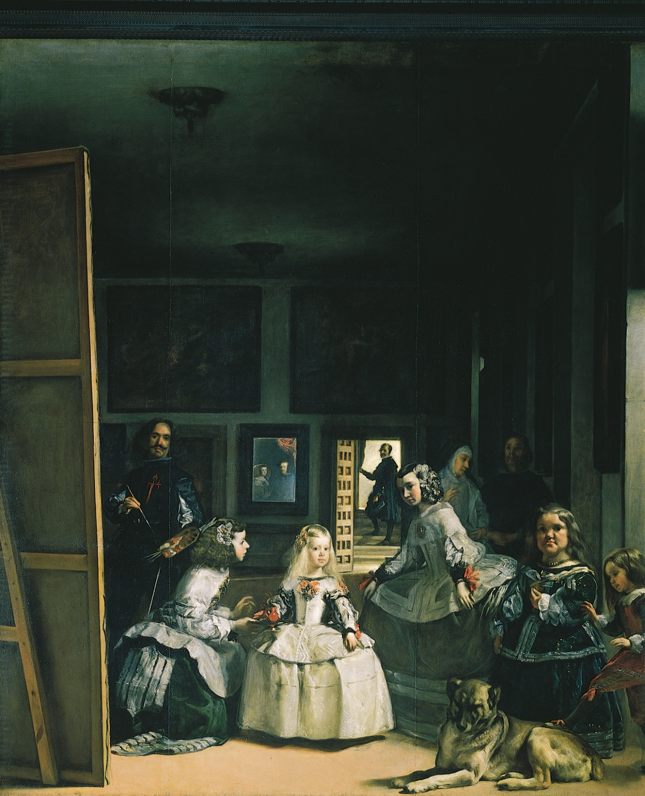
Velazquez
Las Meninas

Slide 3
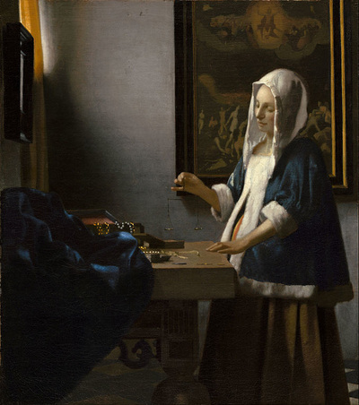
Vermeer
Woman Holding a Balance

Slide 4
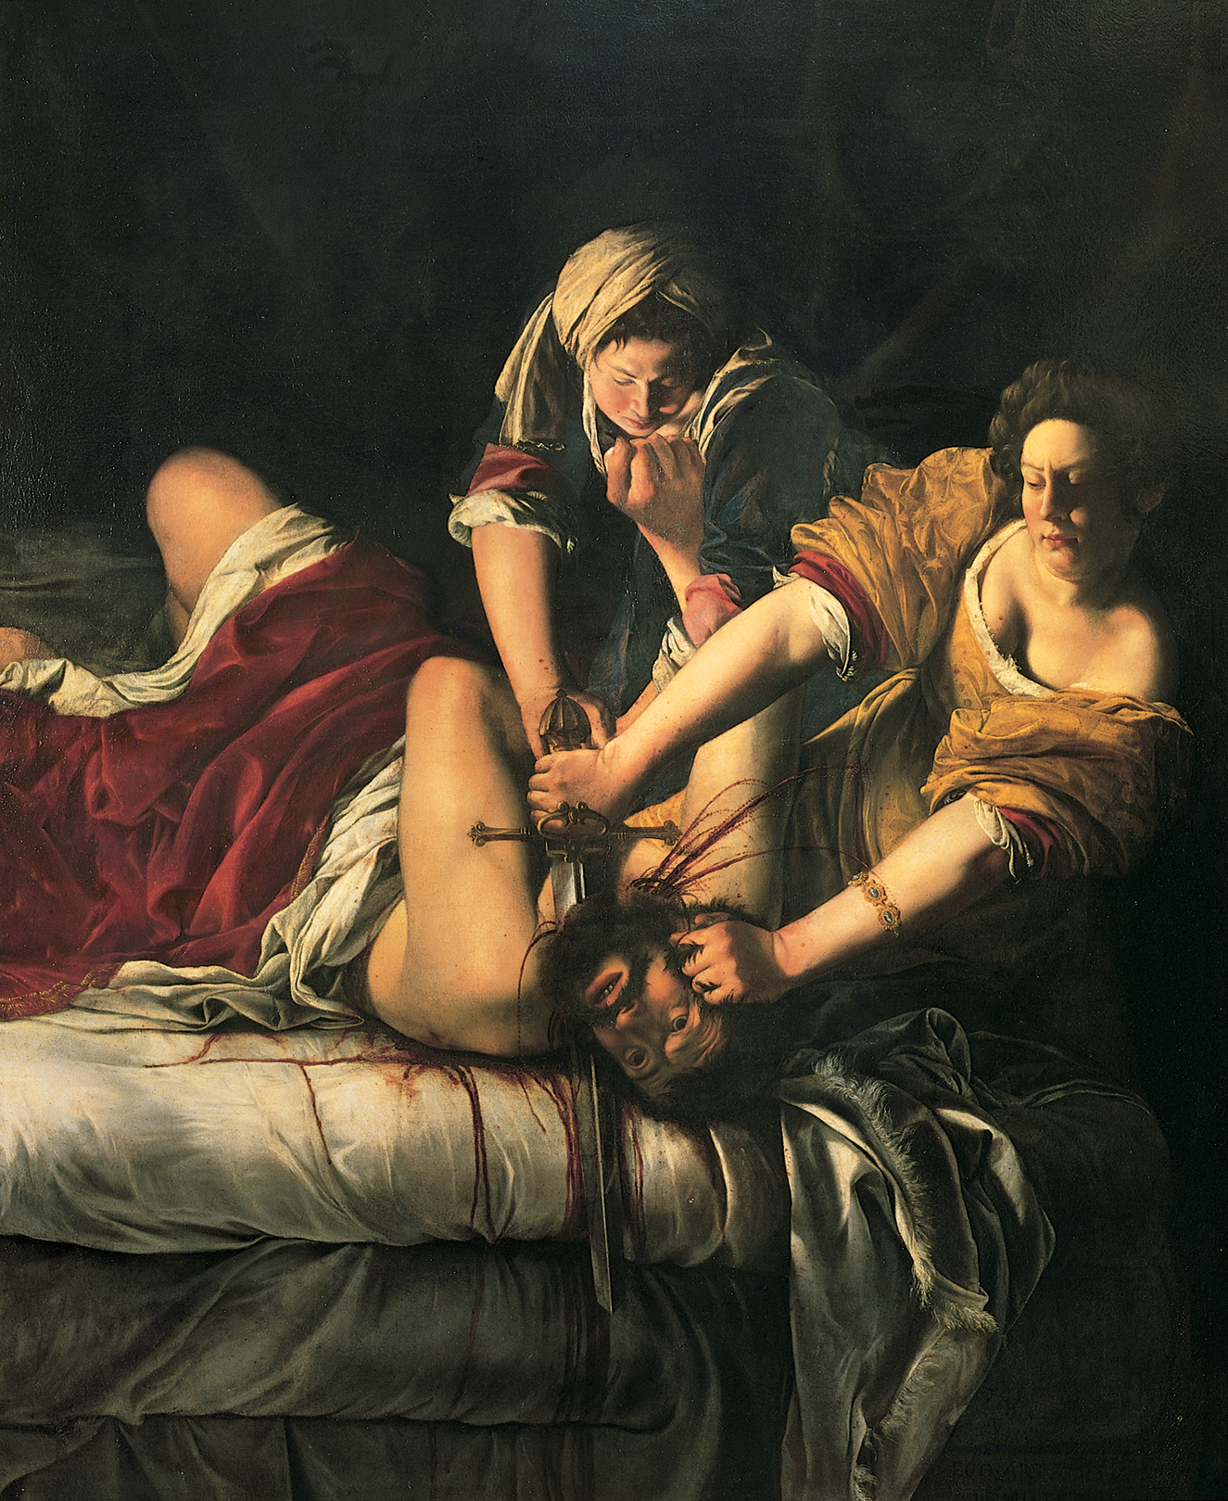
Gentileschi
Judith Slaying Holofernes

Slide 5
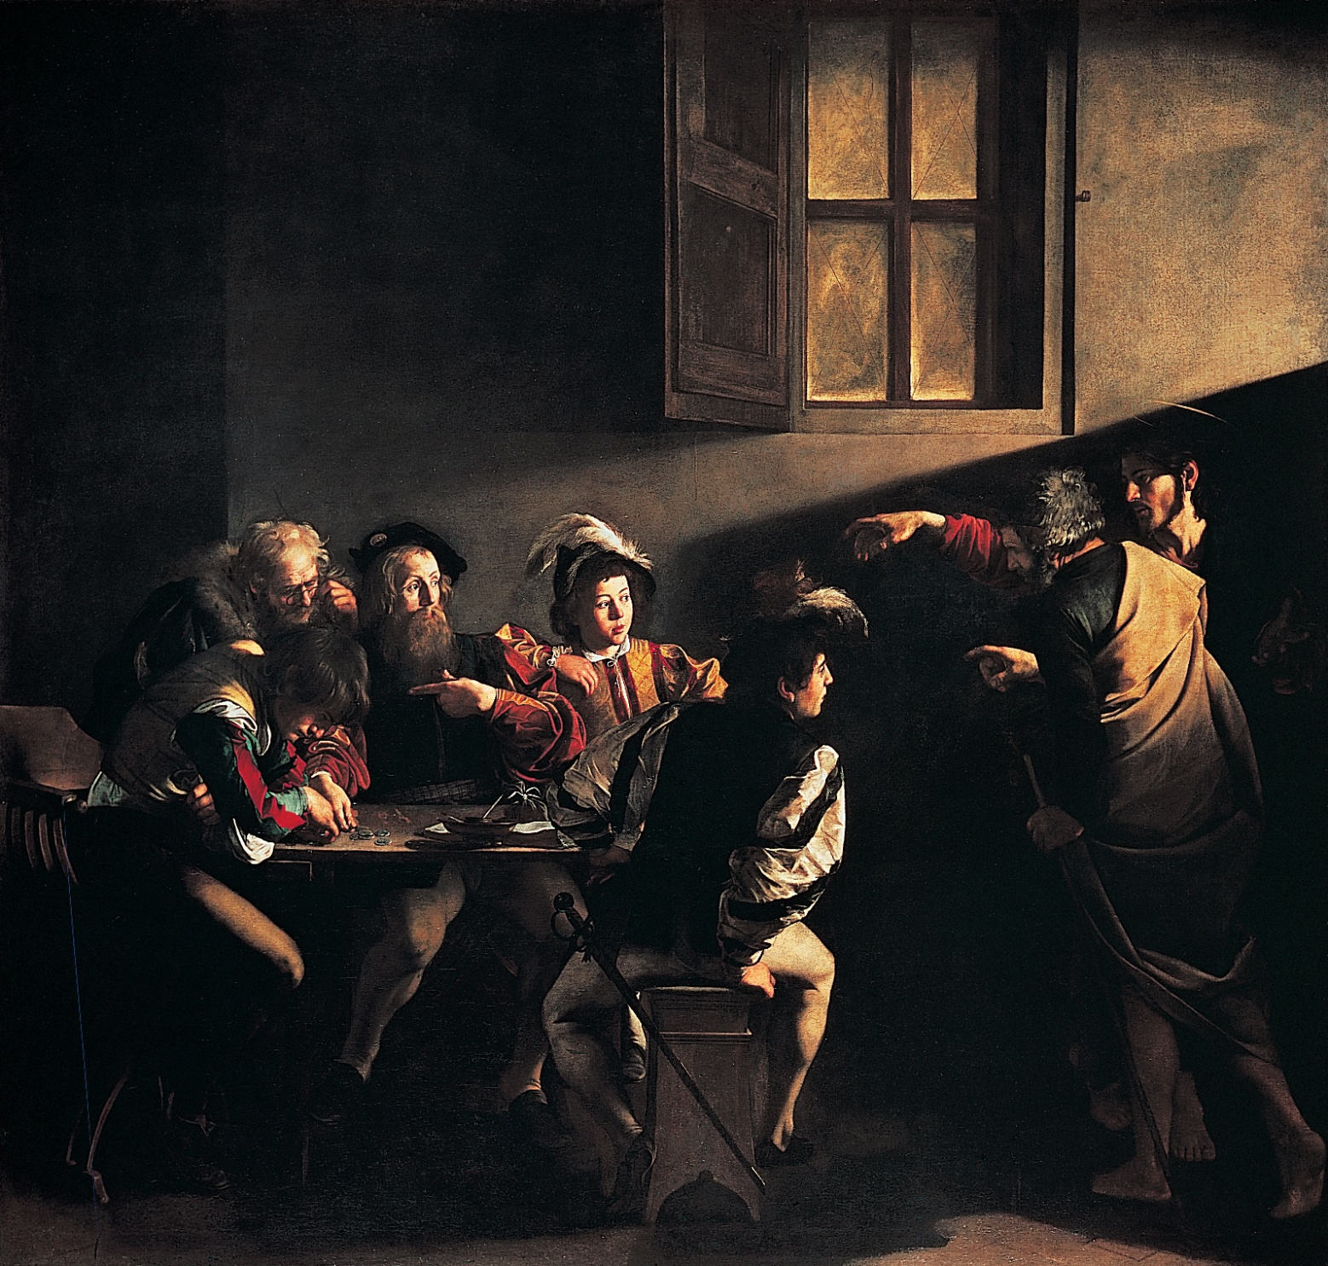
Caravaggio
Calling of Saint Matthew

Slide 6
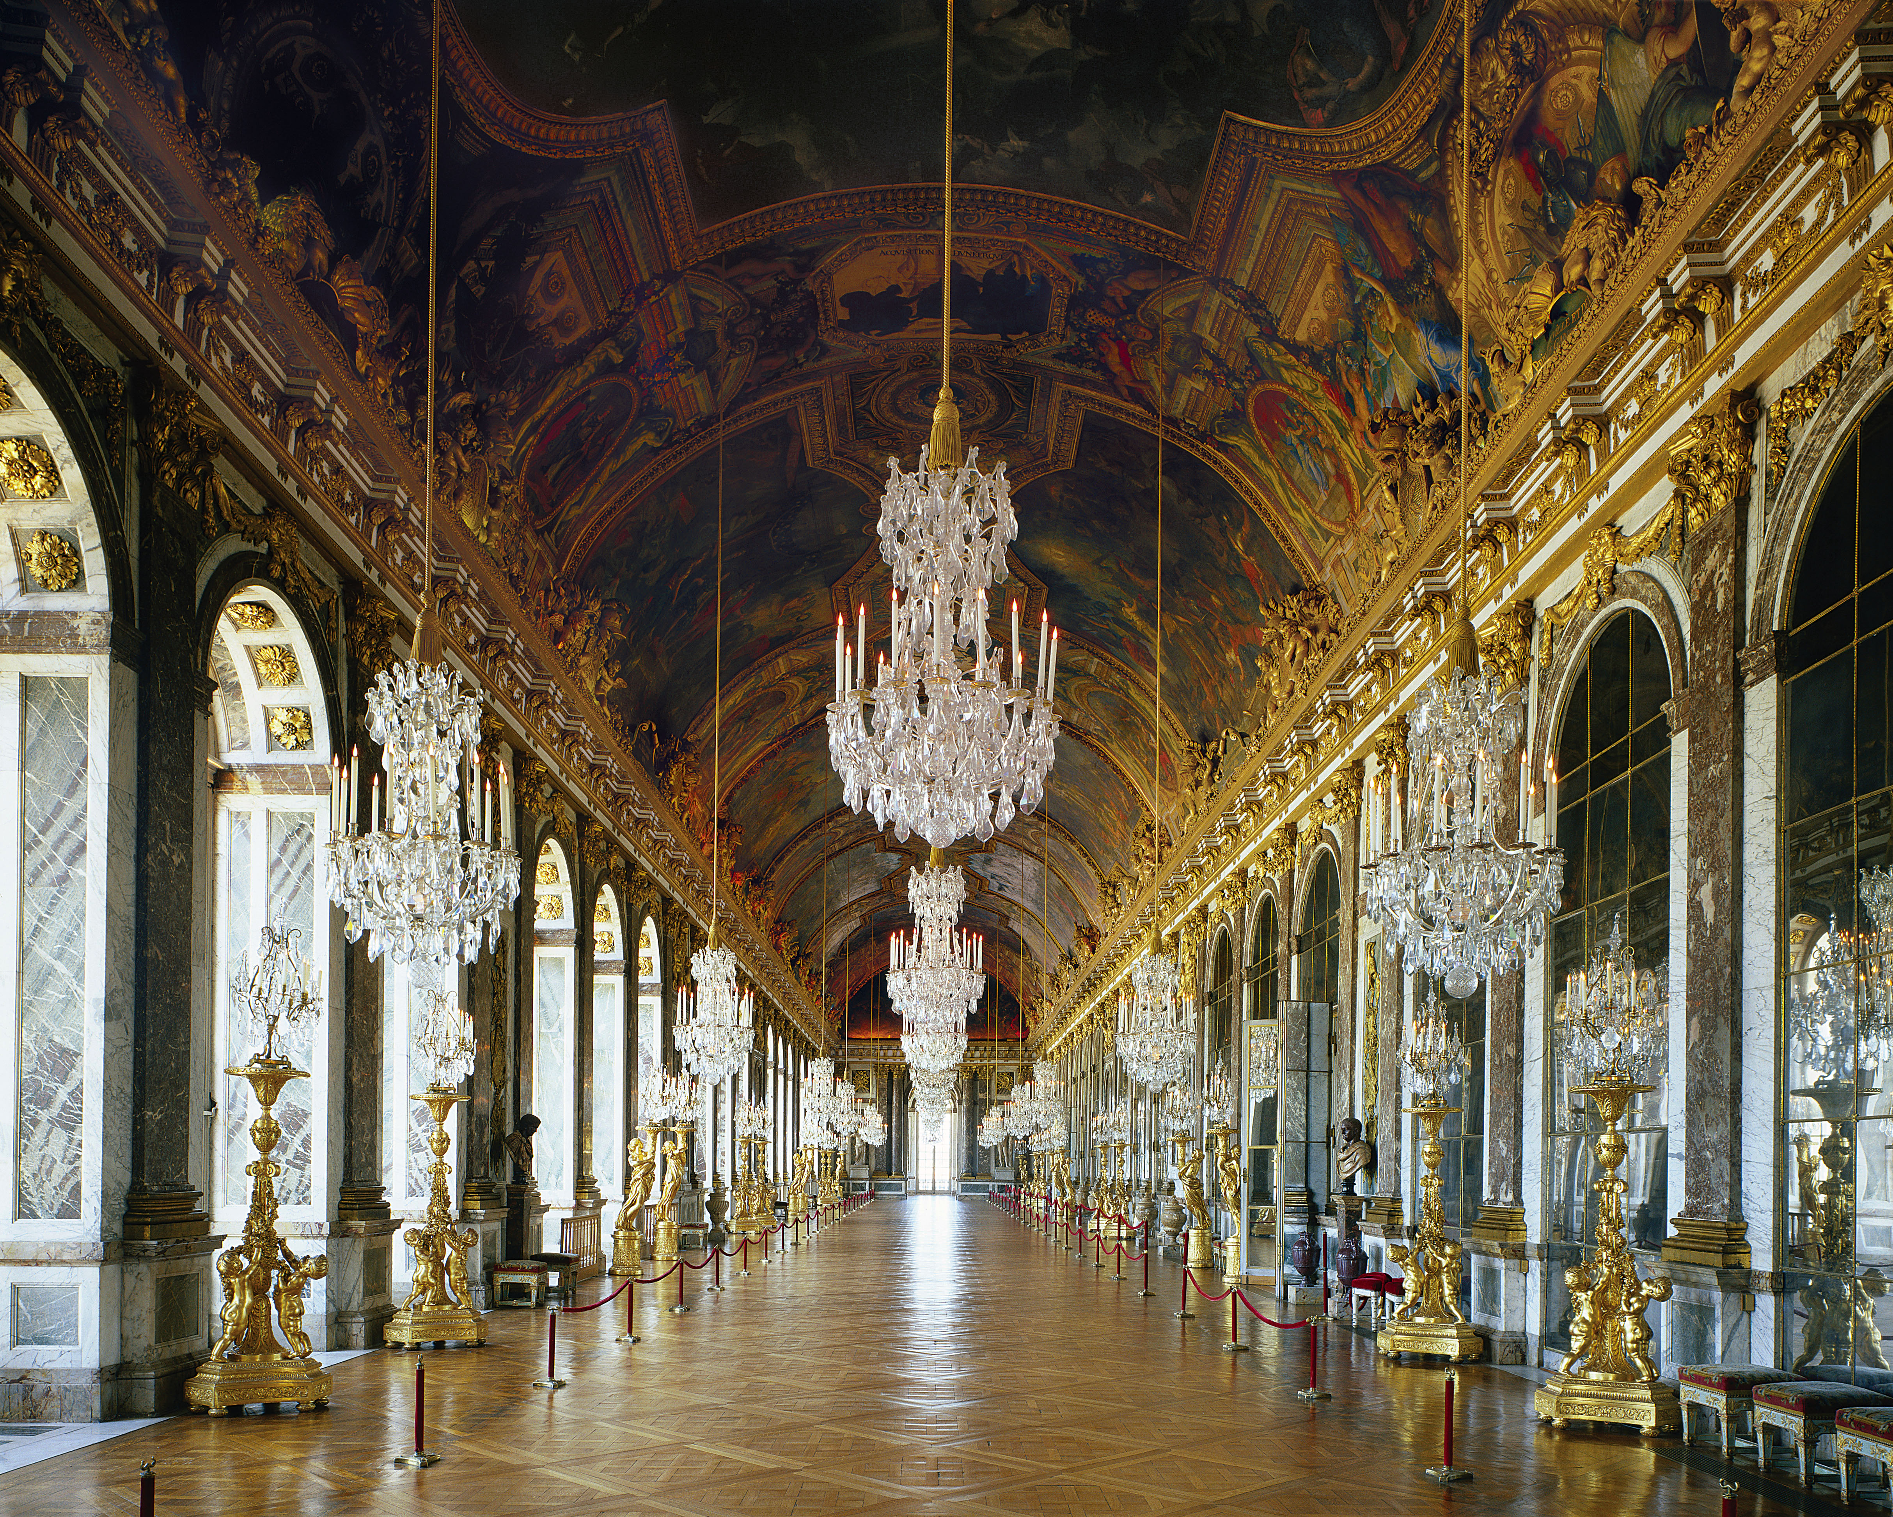
Mansart, Le Brun
Hall of Mirrors,
Versaille

Slide 7
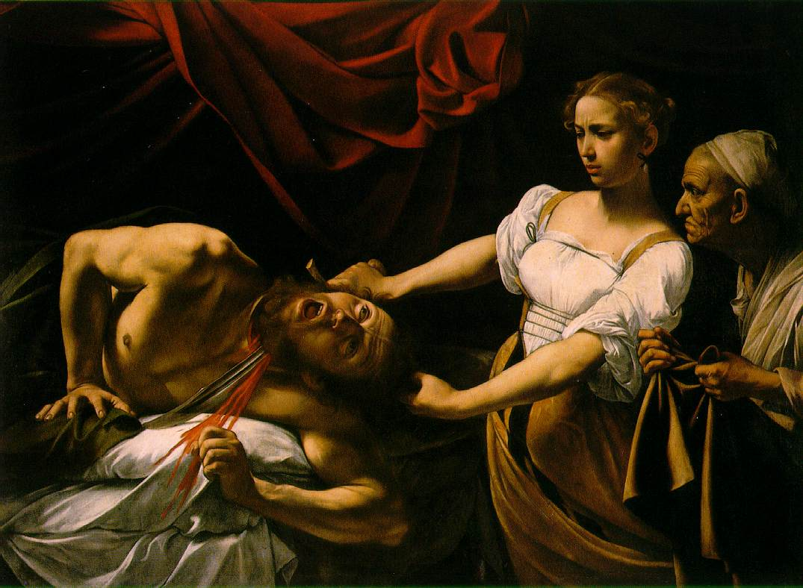
Caravaggio
Judith Slaying Holofernes

Slide 8
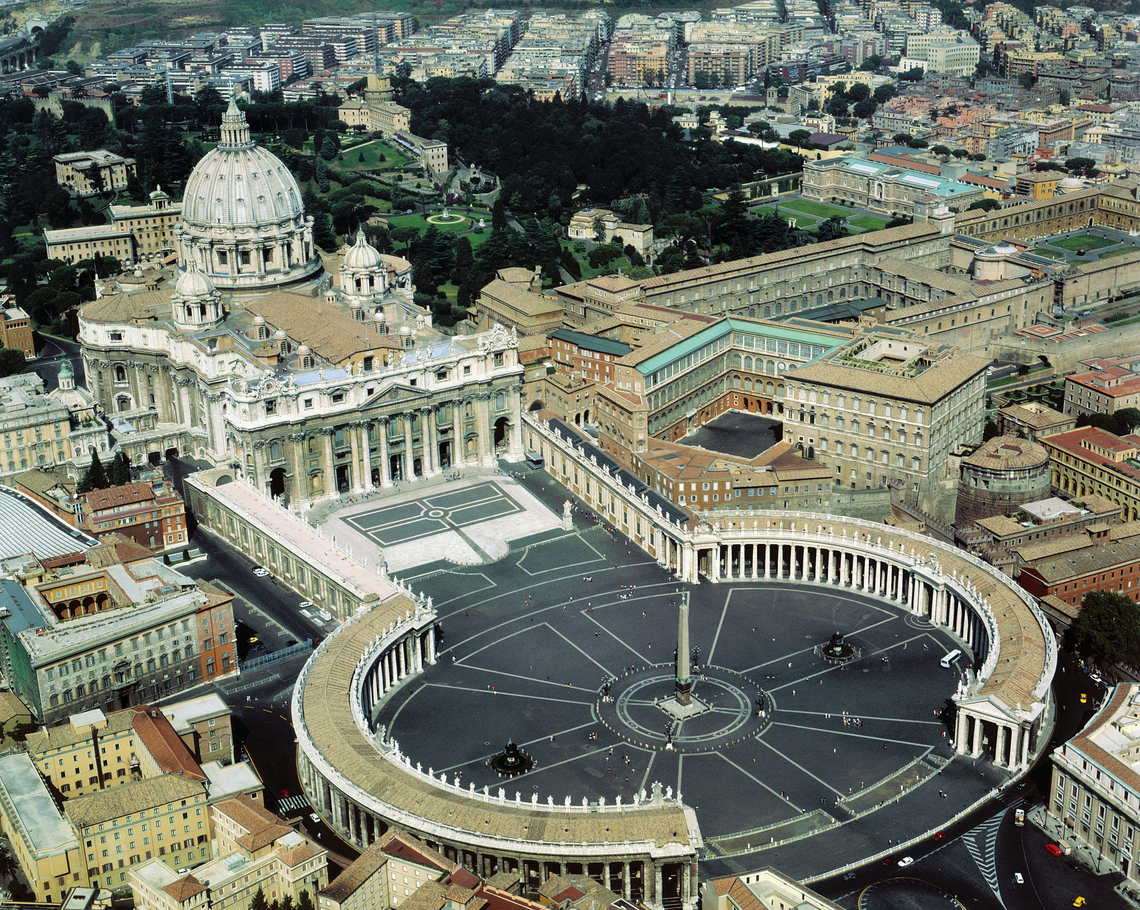
Bernini
St. Peter Piazza

Slide 9
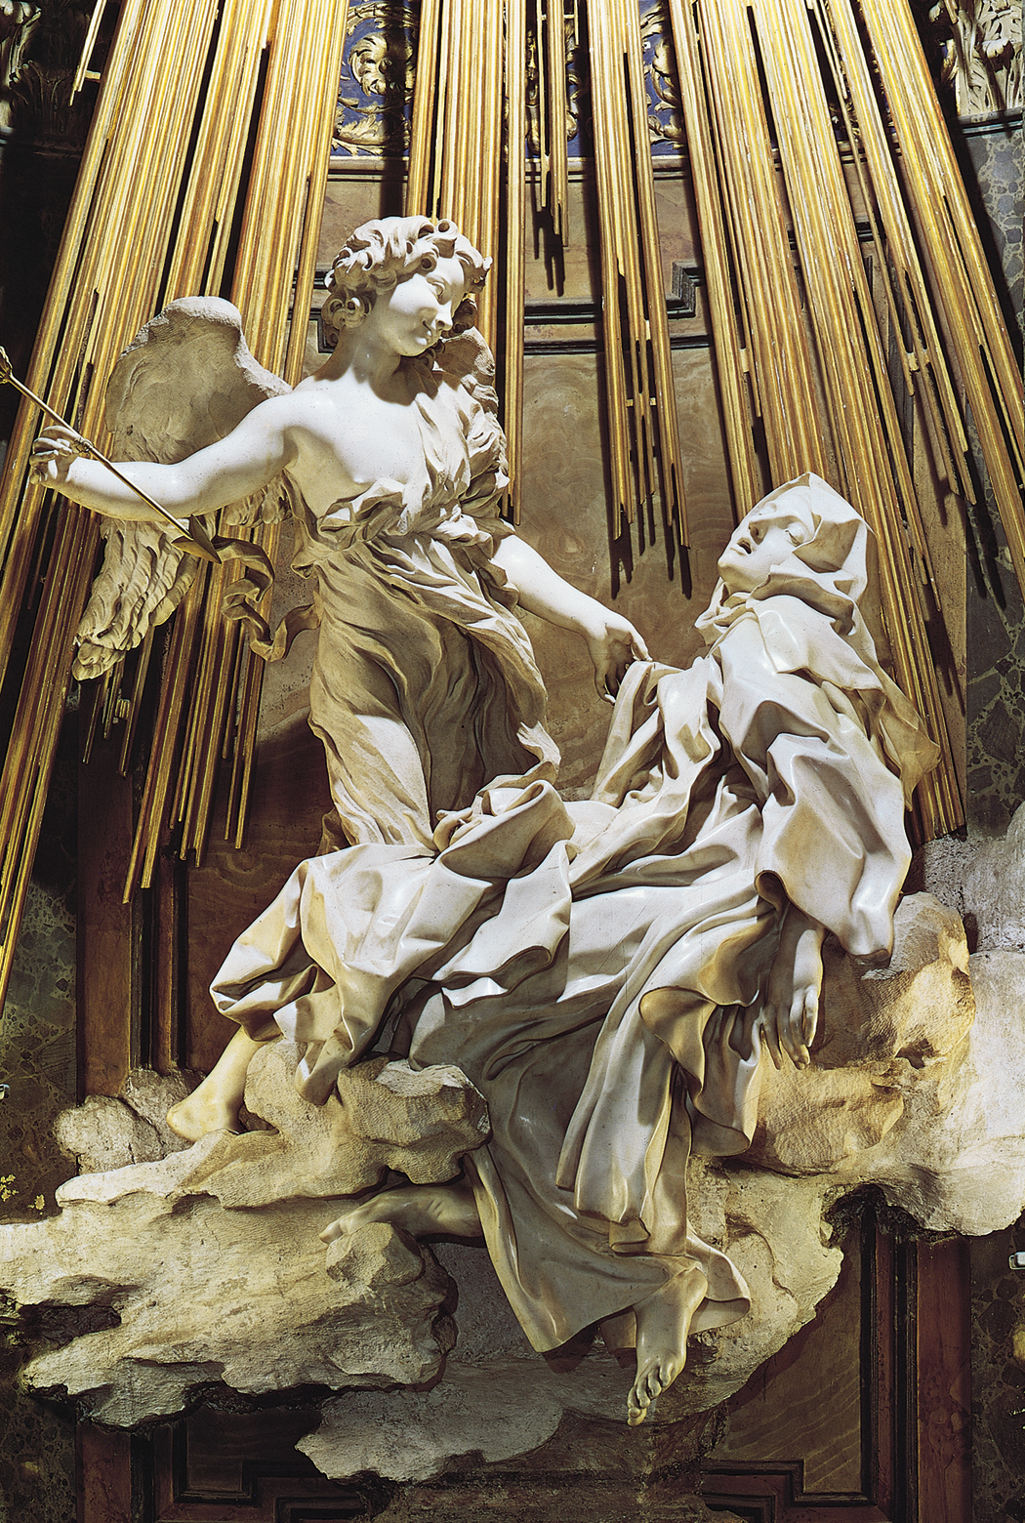
Bernini
Ecstasy of Saint Teresa

Slide 10
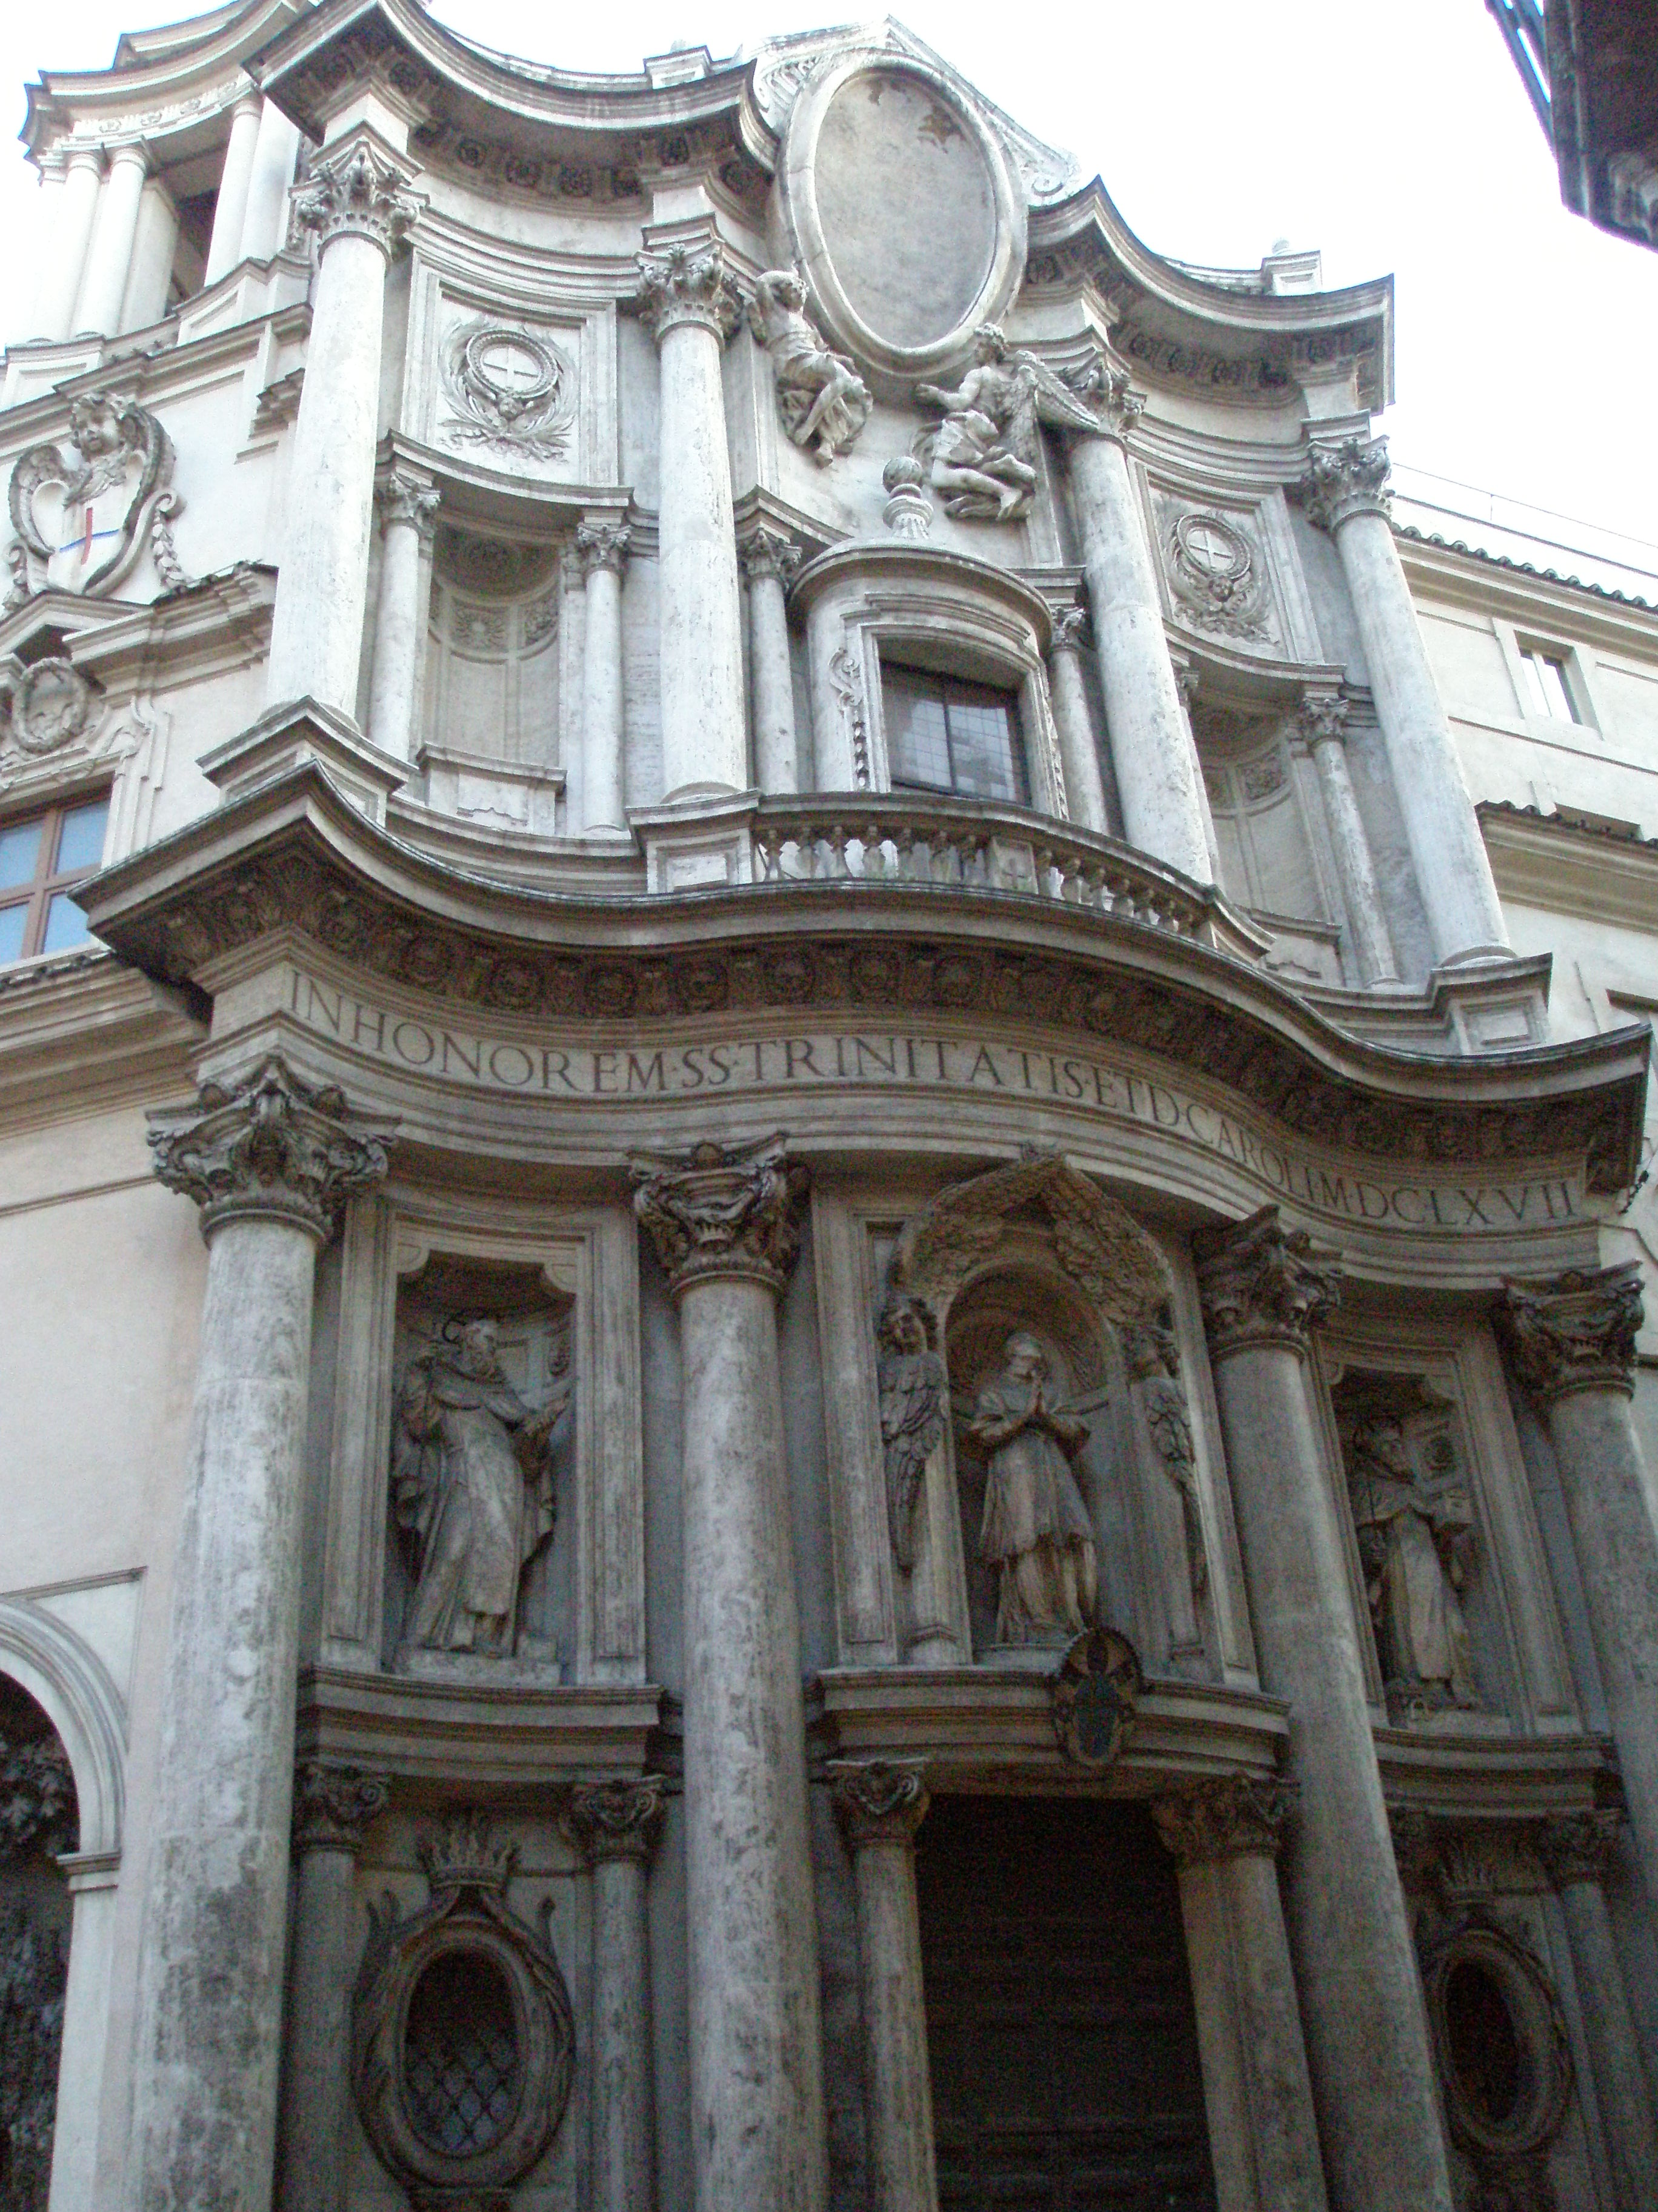
Bernini
St. Charles Church at the Four Fountains
(San Carlo)

Slide 11
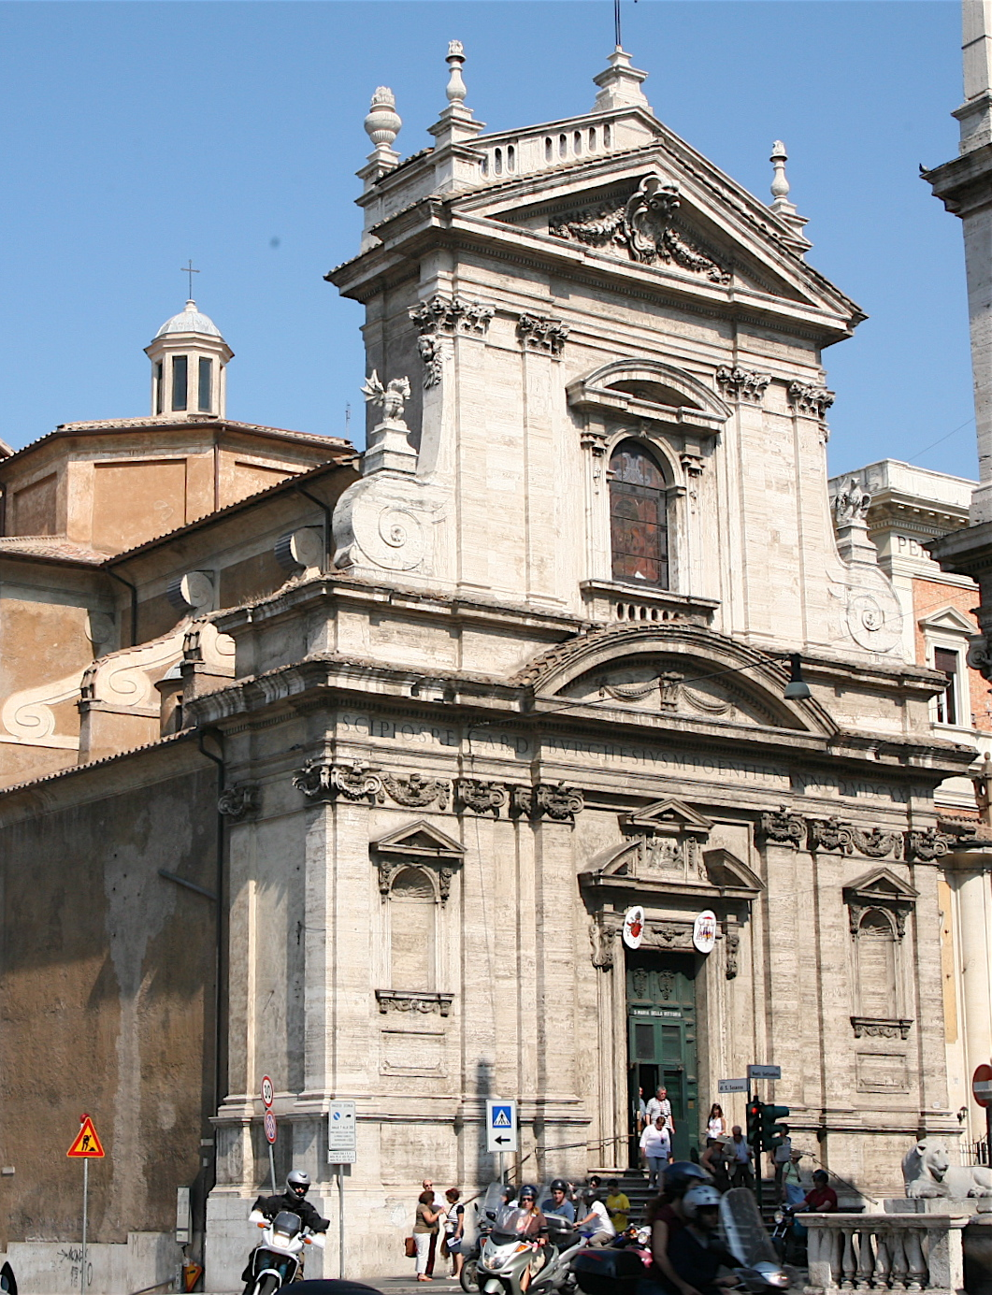
Maderno, Battista
Santa Maria dell Vittoria

Slide 12
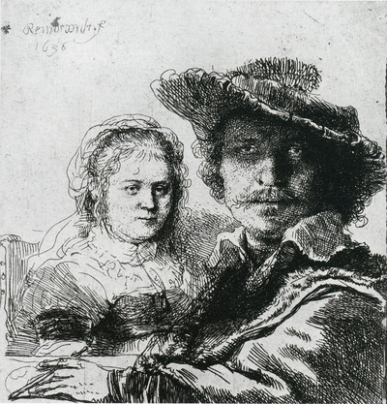
Rembrandt
Self Portrait with Saskia

Slide 13
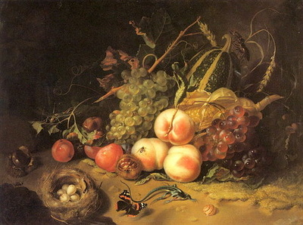
Ruysch
Fruits and Insects

Slide 14
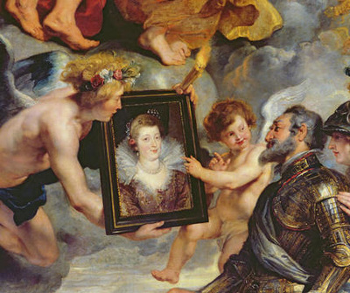
Rubens
Marie de Medici cycle

Slide 15
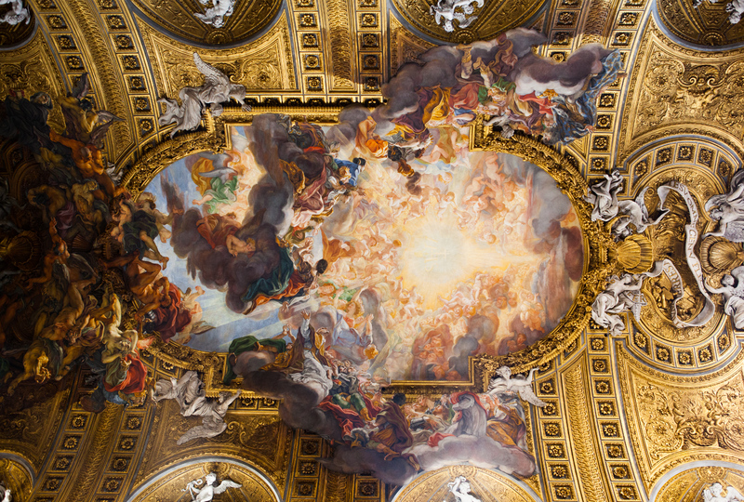
Battista
Triumph of the Name of Jesus

