Slide 1
Northern Renaissance Artists & Titles Review

Slide 2
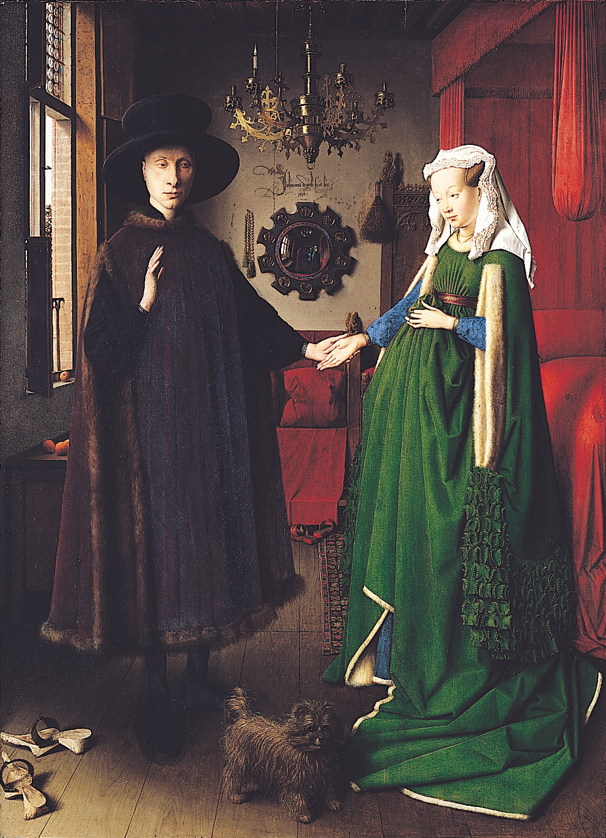
van Eyck
Arnolfini and his Bride

Slide 3
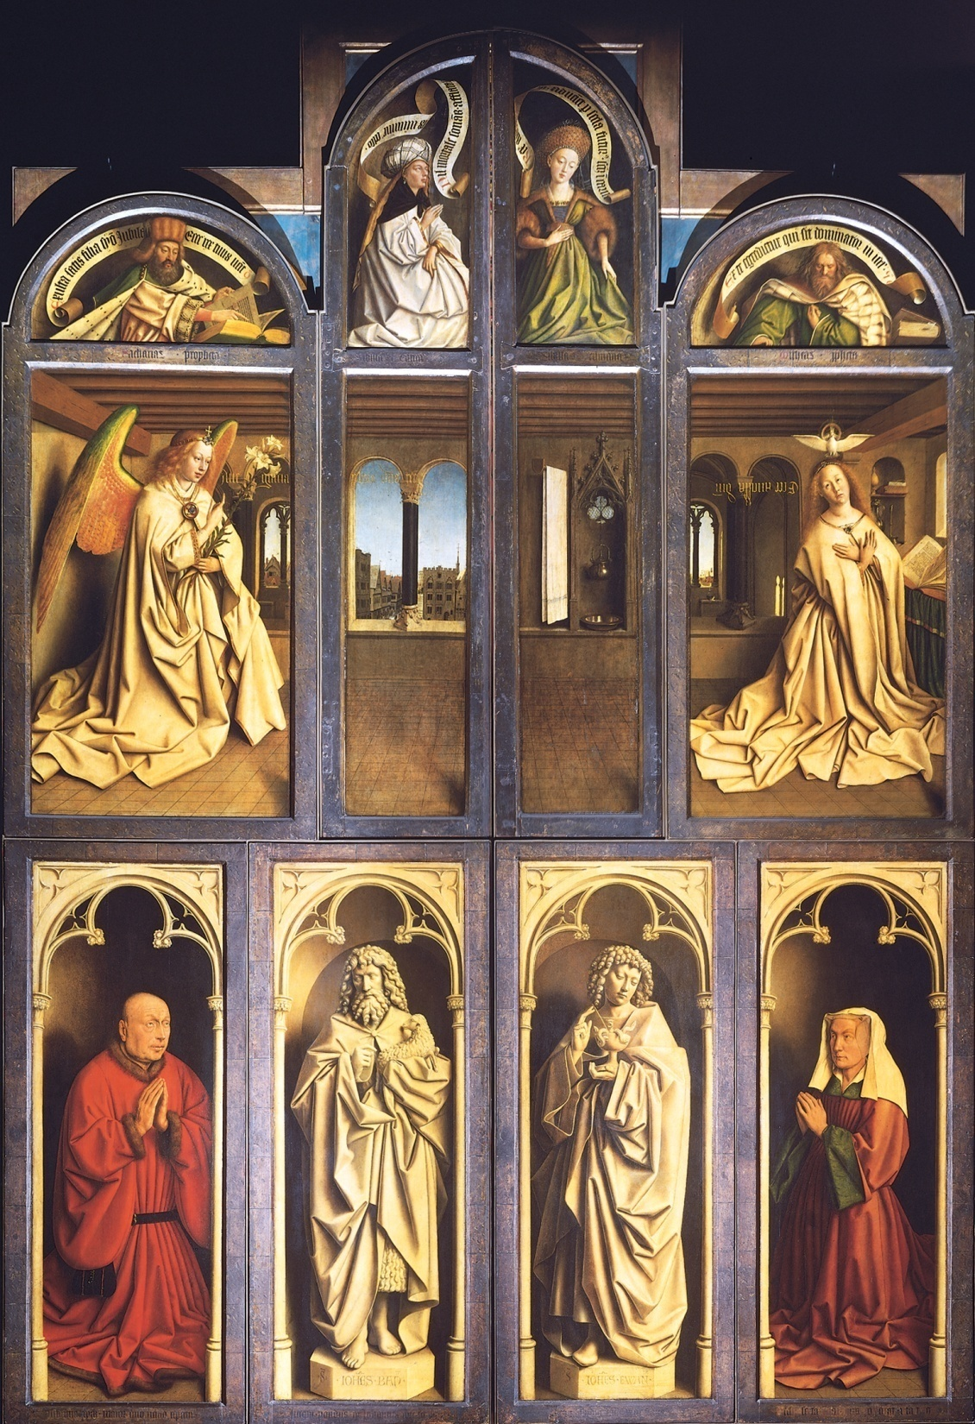
van Eyck
Ghent Altarpiece
(Closed)

Slide 4
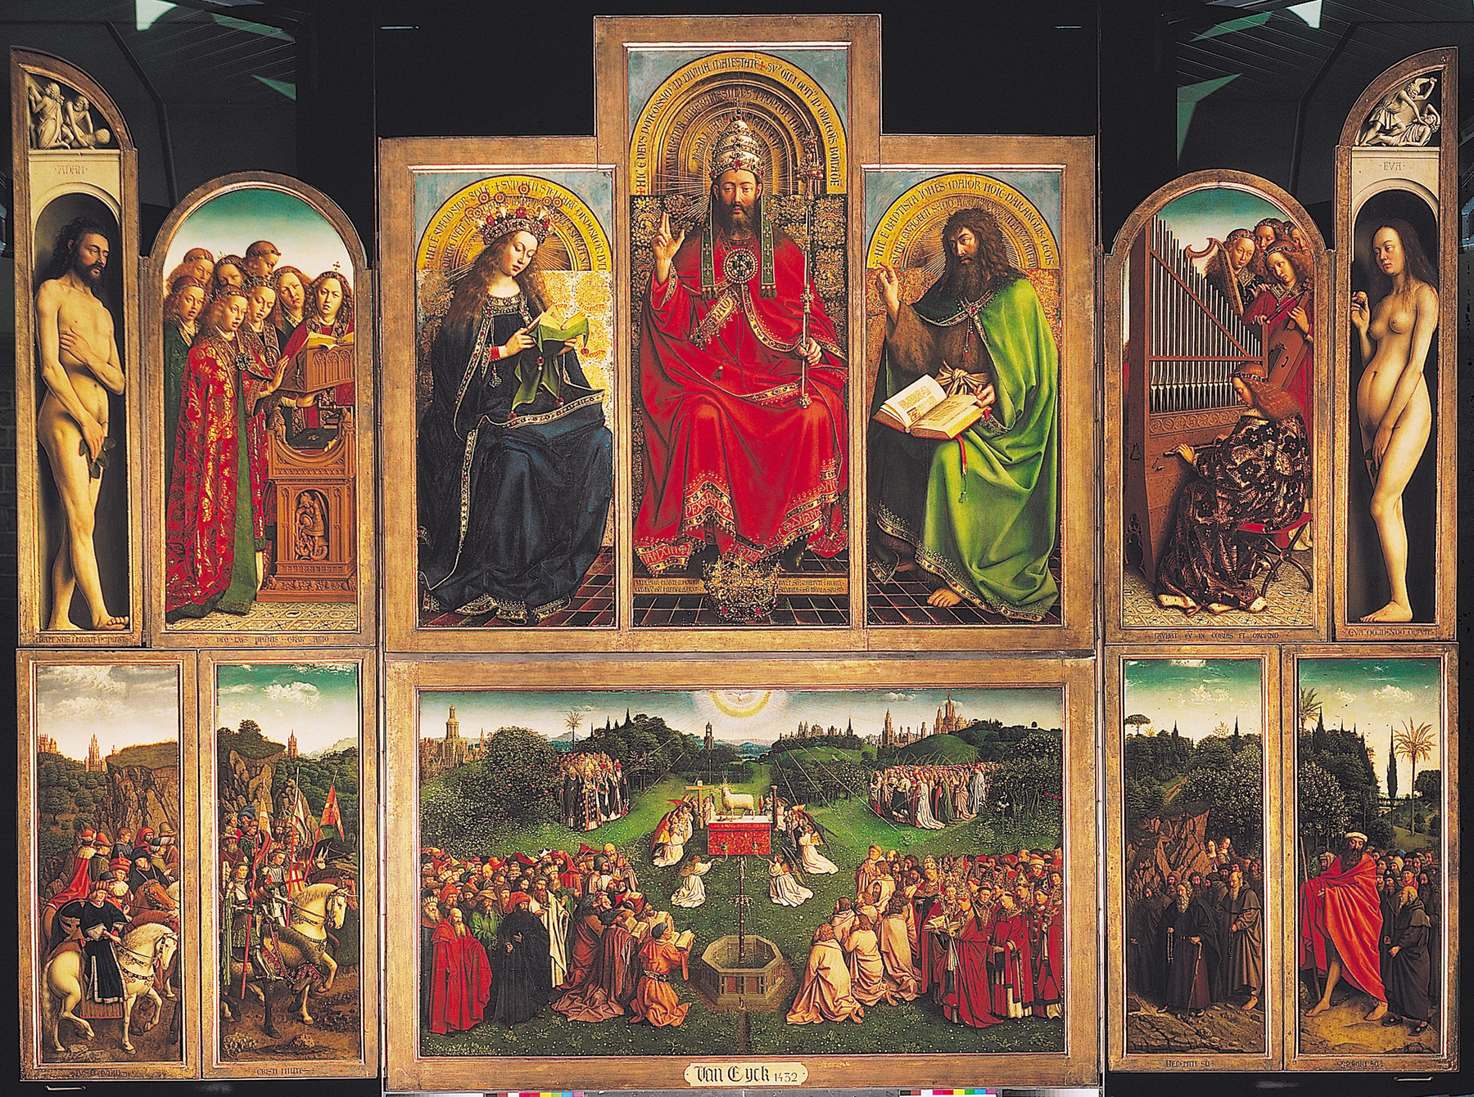
van Eyck
Ghent Altarpiece (opened)

Slide 5
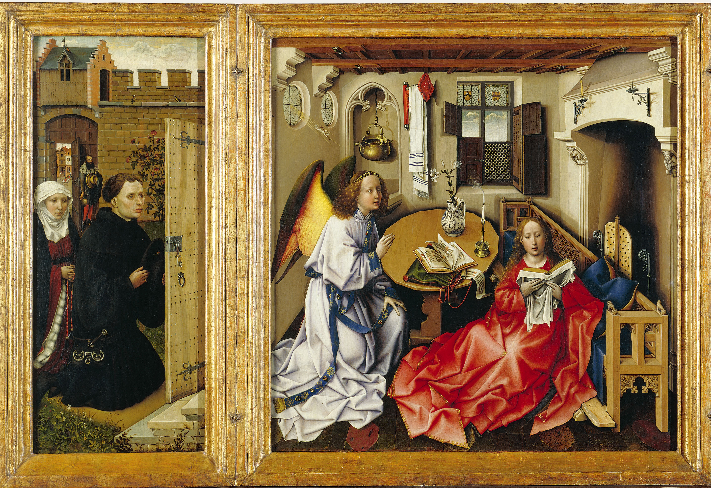
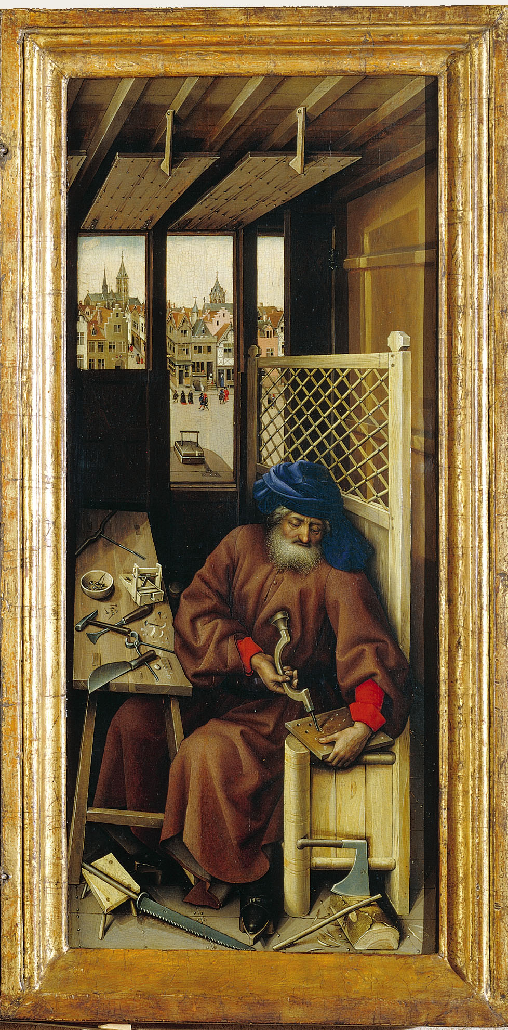
Campin
Merode Altarpiece

Slide 6
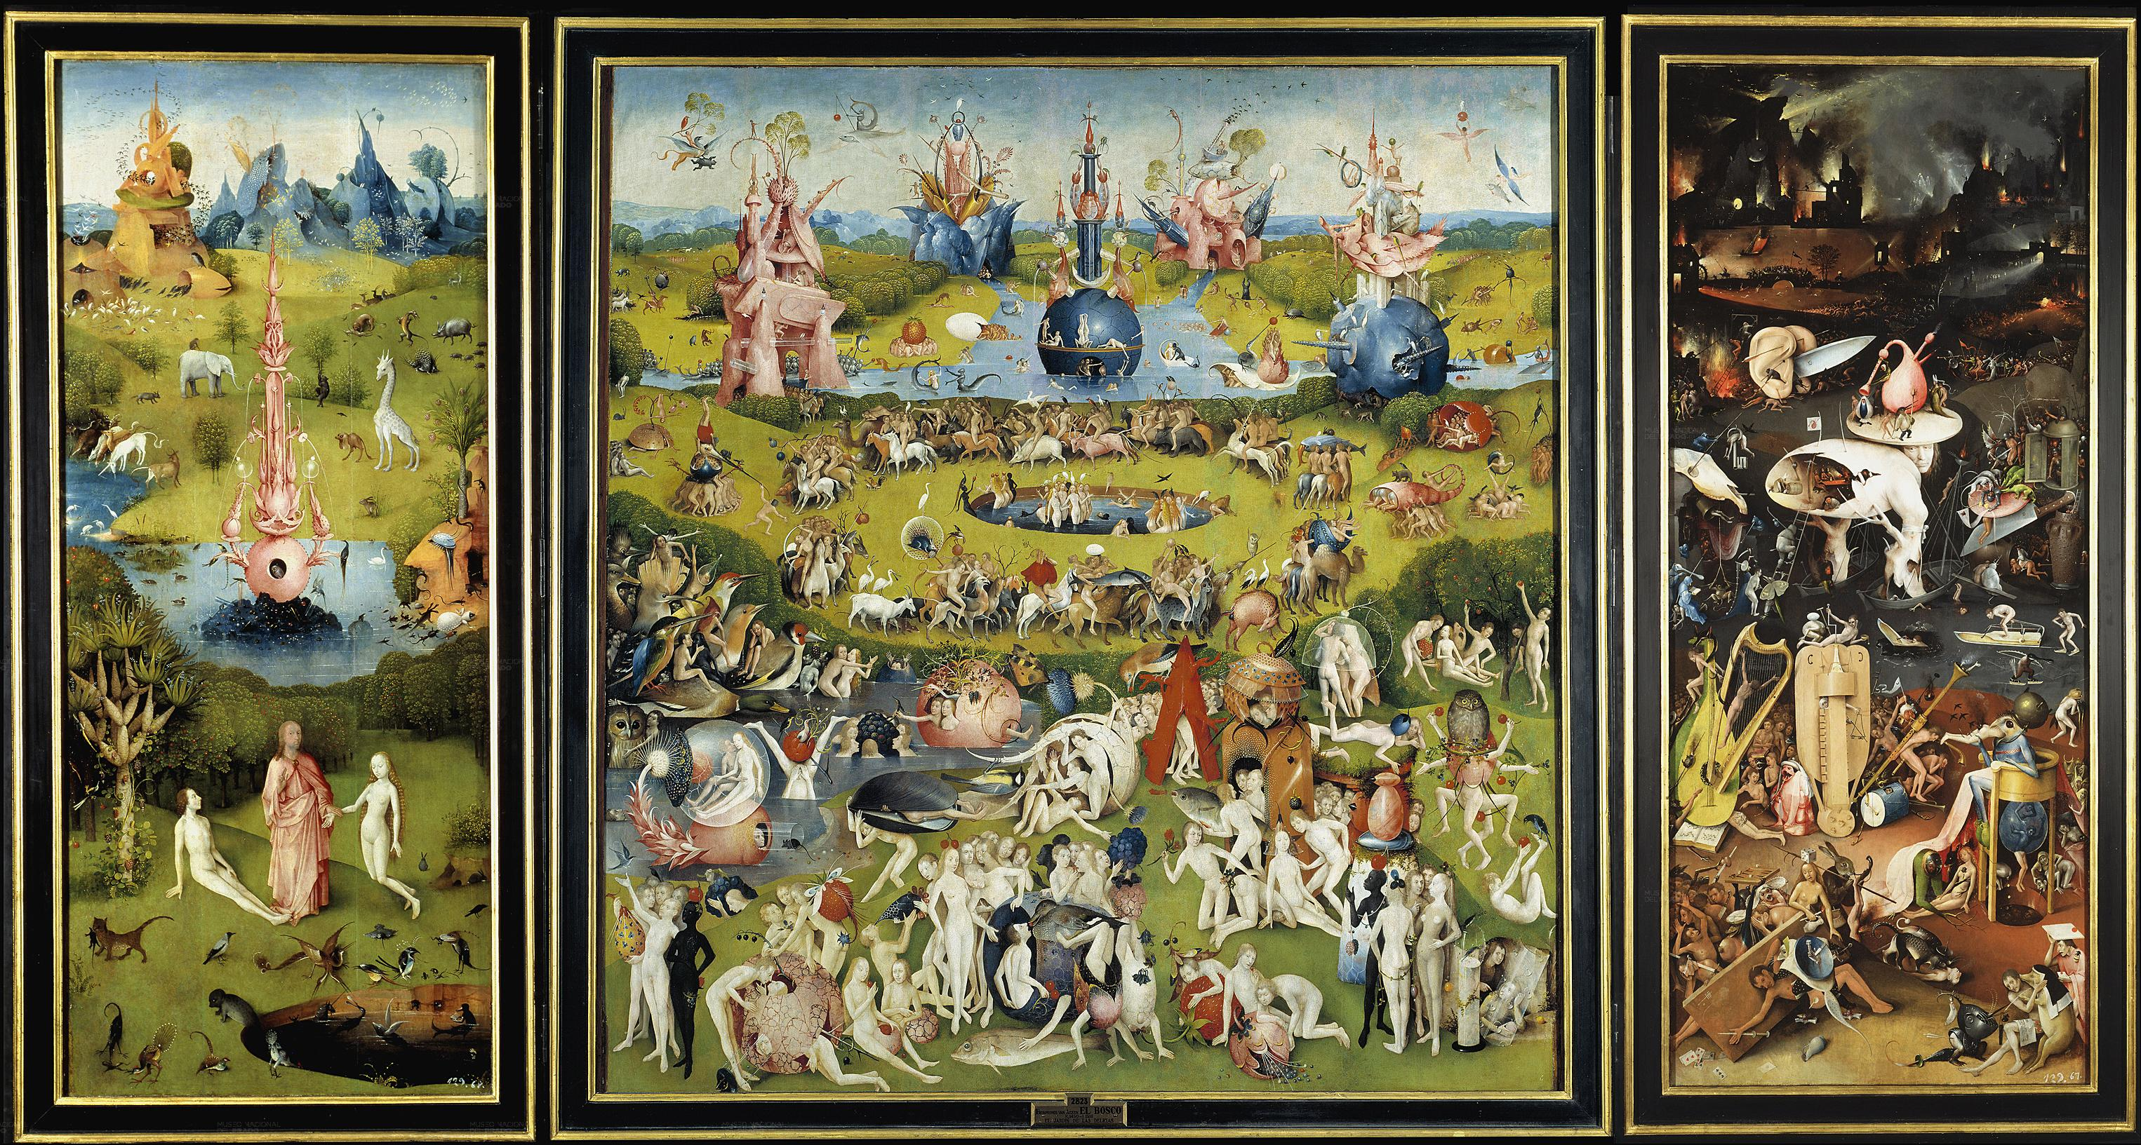
Bosch
Garden of Earthly Delights

Slide 7
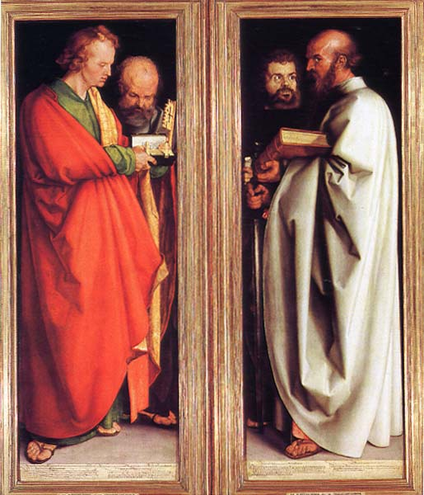
Durer
Four Apostles

Slide 8
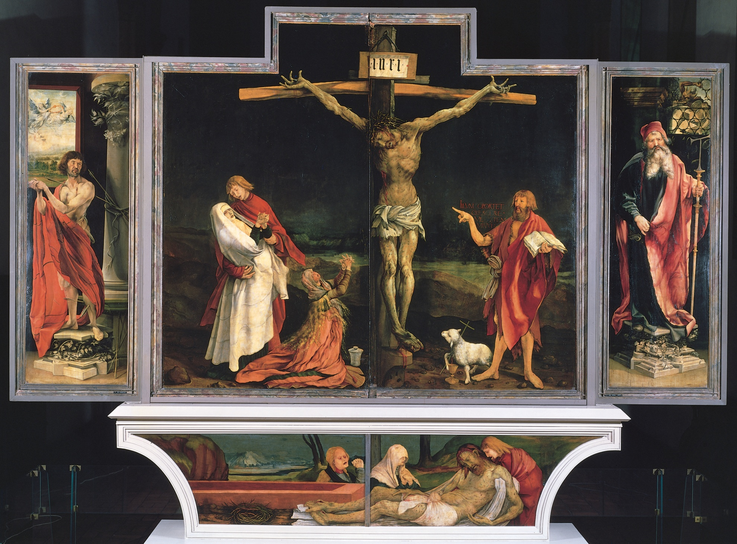
Grunewald
Isenheim Altarpiece

Slide 9
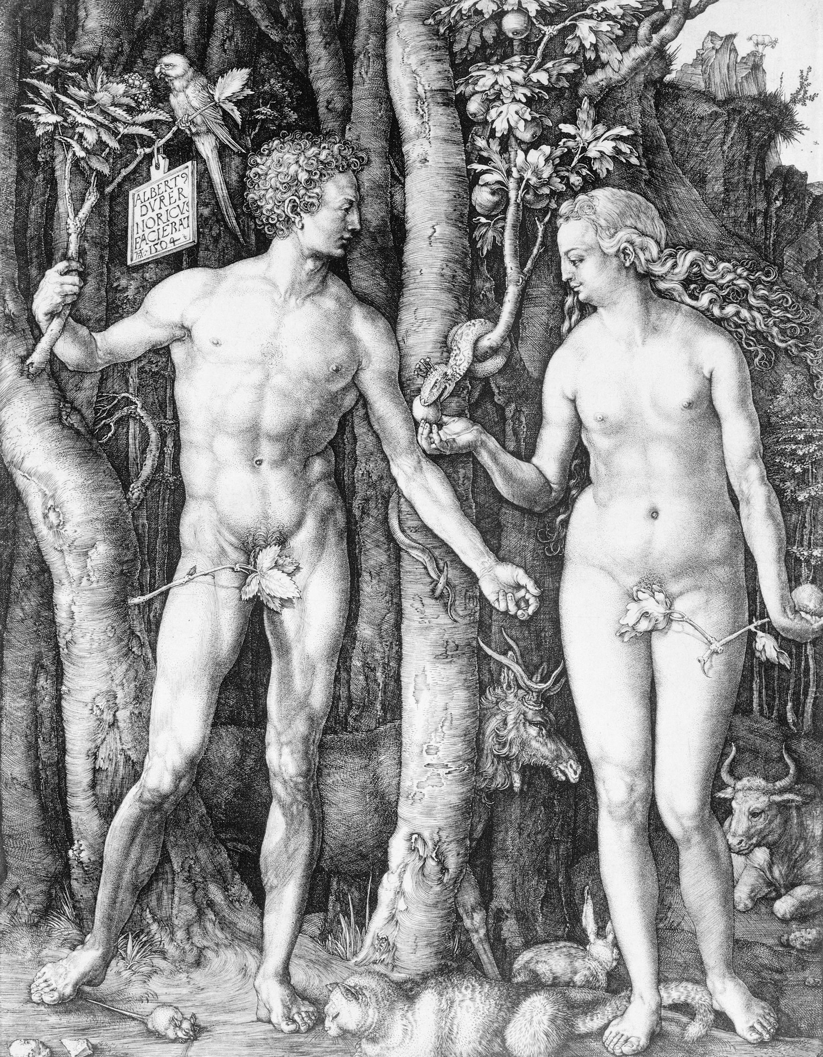
Durer
Fall of Man

Slide 10
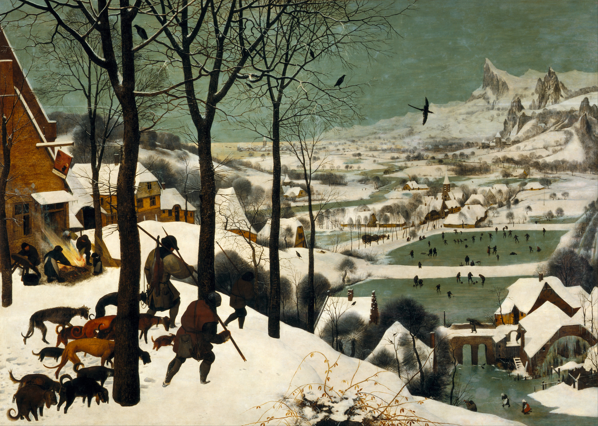
Pieter Bruegel, The Elder
Return of the Hunters

Slide 11
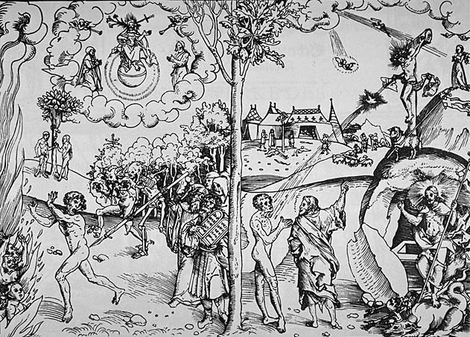
Lucas Cranach, The Elder
Allegory of Law and Grace

Slide 12
van Eyck
Arnolfini and his Bride

Slide 13
Durer
Four Apostles

Slide 14
van Eyck
Ghent Altarpiece (opened)

Slide 15
Durer
Fall of Man

Slide 16
Campin
Merode Altarpiece

Slide 17
Bosch
Garden of Earthly Delights

Slide 18
van Eyck
Ghent Altarpiece
(Closed)

Slide 19
Grunewald
Isenheim Altarpiece

Slide 20
Lucas Cranach, The Elder
Allegory of Law and Grace

Slide 21
van Eyck
Arnolfini and his Bride

Slide 22
Pieter Bruegel, The Elder
Return of the Hunters

Slide 23
Campin
Merode Altarpiece

Slide 24
Durer
Fall of Man

Slide 25
van Eyck
Ghent Altarpiece (opened)

Slide 26
Bosch
Garden of Earthly Delights

Slide 27
Durer
Four Apostles

Slide 28
Lucas Cranach, The Elder
Allegory of Law and Grace

Slide 29
van Eyck
Ghent Altarpiece
(Closed)

Slide 30
Grunewald
Isenheim Altarpiece

Slide 31
Pieter Bruegel, The Elder
Return of the Hunters

Slide 32
Bosch
Garden of Earthly Delights

Slide 33
van Eyck
Ghent Altarpiece
(Closed)

Slide 34
Grunewald
Isenheim Altarpiece

Slide 35
Lucas Cranach, The Elder
Allegory of Law and Grace

Slide 36
van Eyck
Arnolfini and his Bride

Slide 37
Pieter Bruegel, The Elder
Return of the Hunters

Slide 38
Campin
Merode Altarpiece

Slide 39
Durer
Fall of Man

Slide 40
van Eyck
Ghent Altarpiece (opened)

Slide 41
Bosch
Garden of Earthly Delights

Slide 42
Durer
Four Apostles

Slide 43
Lucas Cranach, The Elder
Allegory of Law and Grace

Slide 44
van Eyck
Ghent Altarpiece
(Closed)

Slide 45
Grunewald
Isenheim Altarpiece

Slide 46
Pieter Bruegel, The Elder
Return of the Hunters

