Slide 1
Artists Review! High Renaissance and Mannerism

Slide 2
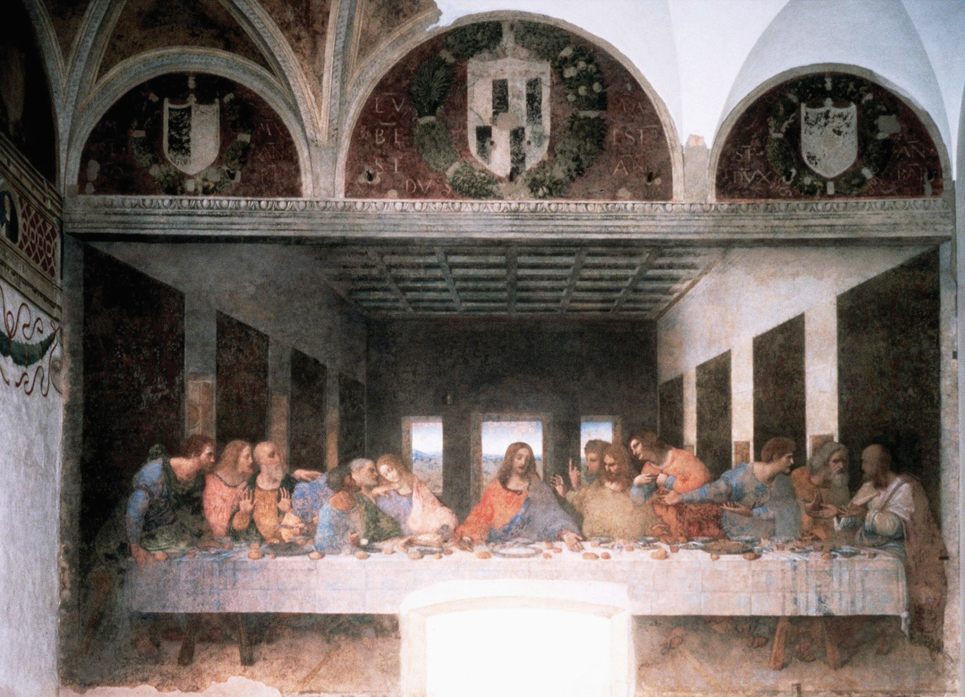
da Vinci
The Last Supper

Slide 3
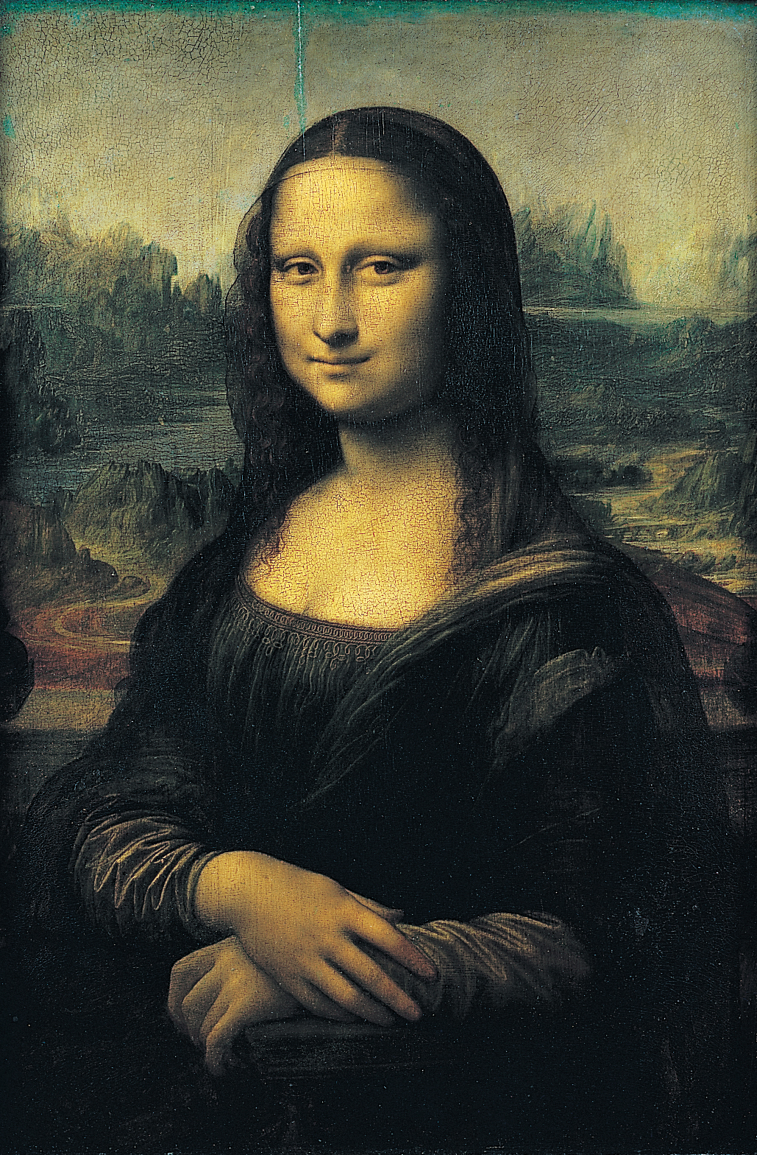
da Vinci
Mona Lisa

Slide 4
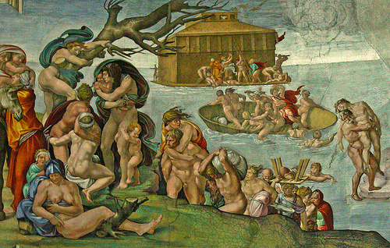
Michelangelo
The Flood,
Sistine Chapel

Slide 5
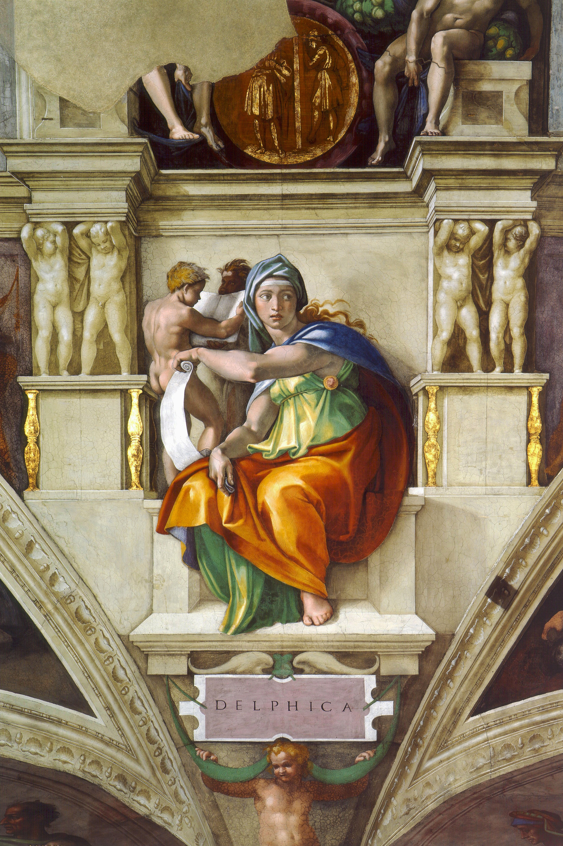
Michelangelo
Delphic Sibyl,
Sistine Chapel

Slide 6
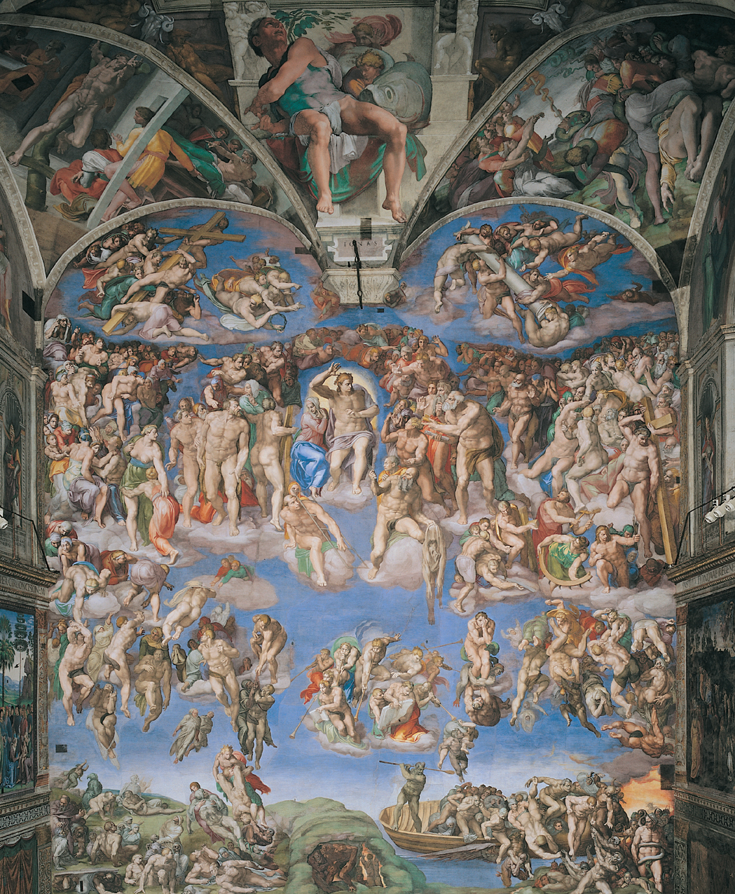
Michelangelo
Last Judgment

Slide 7
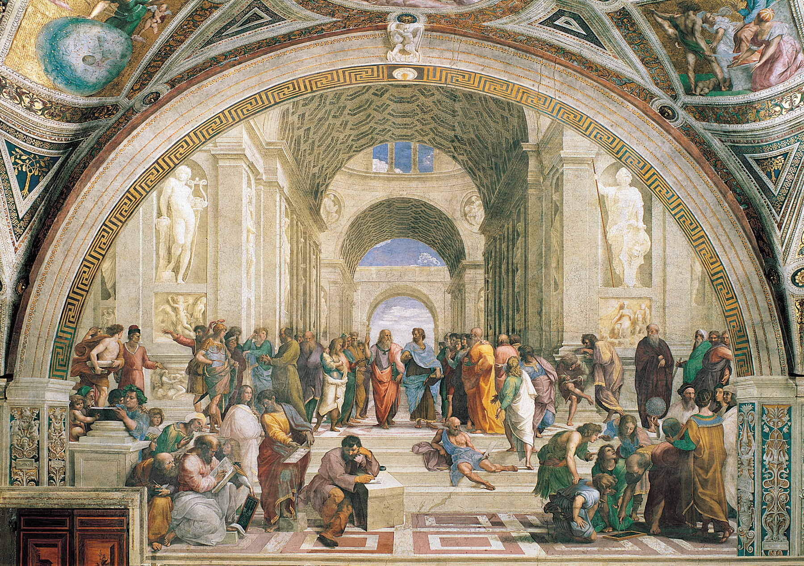
Raphael
School of Athens

Slide 8
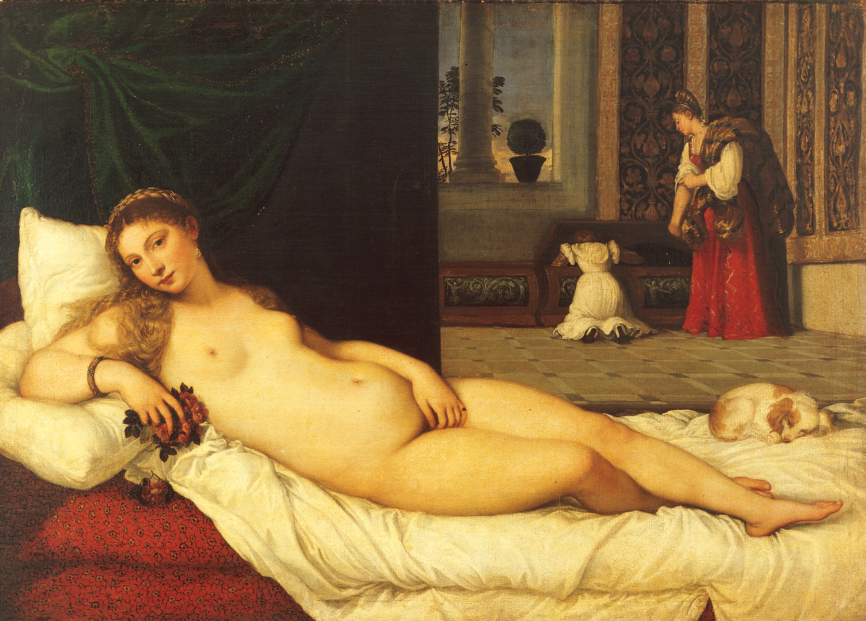
Titian
Venus of Urbino

Slide 9
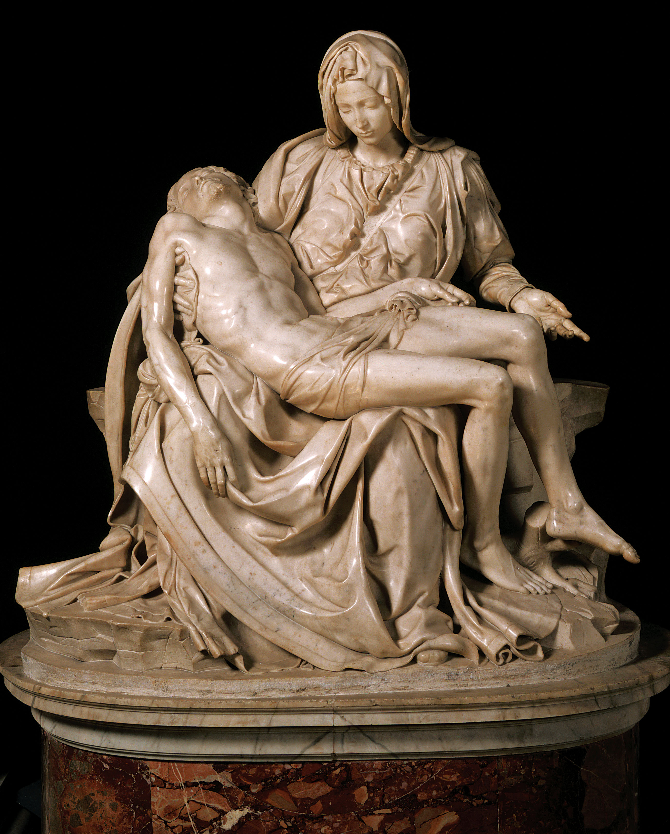
Michelangelo
Pieta

Slide 10
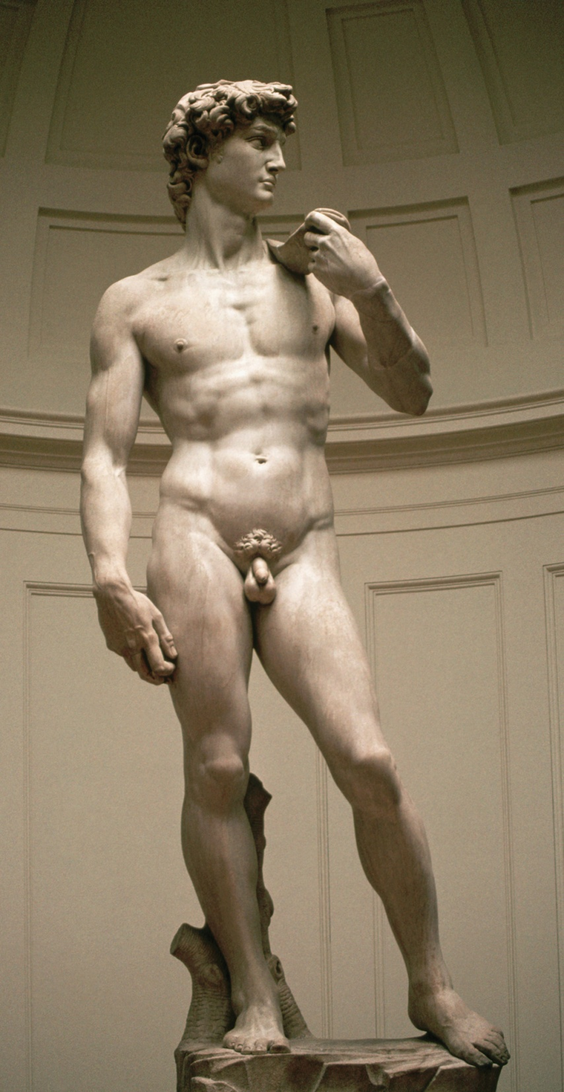
Michelangelo
David

Slide 11
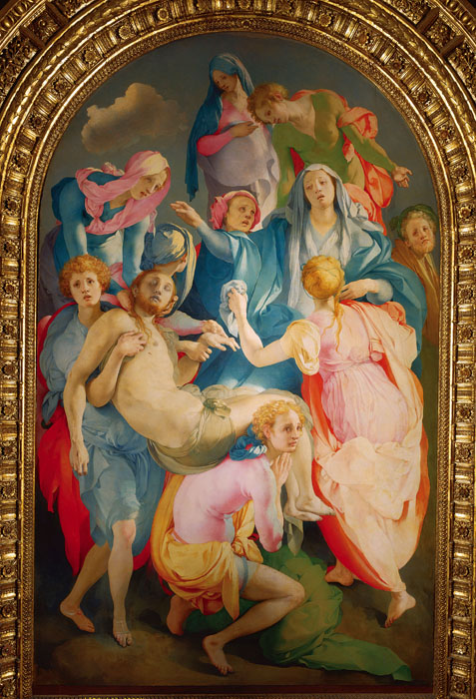
Pontormo
Entombment of Christ
Mannerism

Slide 12
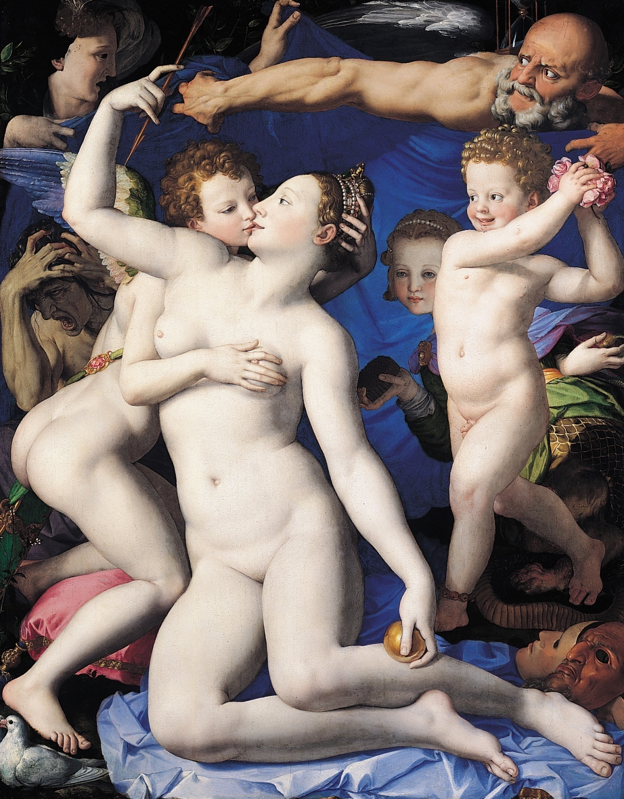
Bronzino
Venus Cupid Folly and Time
Mannerism

Slide 13
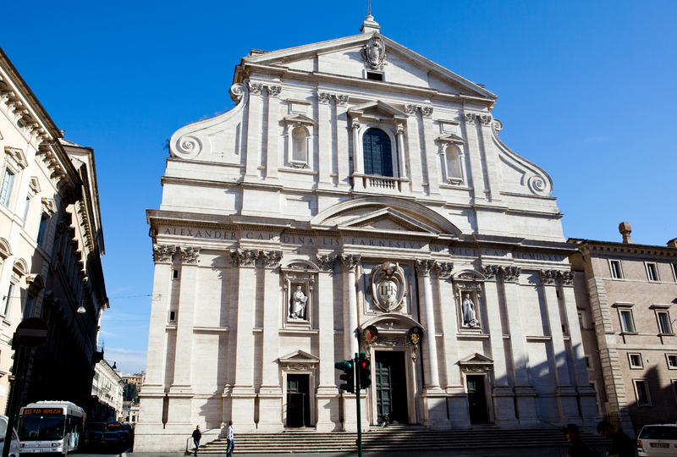
Della Porta
Il Gesu facade
Mannerism

Slide 14
da Vinci
The Last Supper

Slide 15
Pontormo
Entombment of Christ
Mannerism

Slide 16
Michelangelo
Pieta

Slide 17
da Vinci
Mona Lisa

Slide 18
Michelangelo
David

Slide 19
Raphael
School of Athens

Slide 20
Michelangelo
Delphic Sibyl,
Sistine Chapel

Slide 21
Titian
Venus of Urbino

Slide 22
Bronzino
Venus Cupid Folly and Time
Mannerism

Slide 23
Michelangelo
Last Judgment

Slide 24
Della Porta
Il Gesu facade
Mannerism

Slide 25
Michelangelo
The Flood,
Sistine Chapel

Slide 26
da Vinci
The Last Supper

Slide 27
Pontormo
Entombment of Christ
Mannerism

Slide 28
Michelangelo
Pieta

Slide 29
da Vinci
Mona Lisa

Slide 30
Raphael
School of Athens

Slide 31
Titian
Venus of Urbino

Slide 32
Raphael
School of Athens

Slide 33
Bronzino
Venus Cupid Folly and Time
Mannerism

Slide 34
Michelangelo
Delphic Sibyl,
Sistine Chapel

Slide 35
da Vinci
Mona Lisa

Slide 36
Bronzino
Venus Cupid Folly and Time
Mannerism

Slide 37
Michelangelo
David

Slide 38
Michelangelo
Last Judgment

Slide 39
Michelangelo
Delphic Sibyl,
Sistine Chapel

Slide 40
Della Porta
Il Gesu facade
Mannerism

Slide 41
Michelangelo
The Flood,
Sistine Chapel

Slide 42
da Vinci
The Last Supper

Slide 43
Michelangelo
David

Slide 44
Pontormo
Entombment of Christ
Mannerism

Slide 45
Michelangelo
Pieta

Slide 46
Michelangelo
The Flood,
Sistine Chapel

Slide 47
Michelangelo
Last Judgment

Slide 48
Titian
Venus of Urbino

Slide 49
Della Porta
Il Gesu facade
Mannerism

Slide 50
Michelangelo
The Flood,
Sistine Chapel

Slide 51
da Vinci
The Last Supper

Slide 52
Pontormo
Entombment of Christ
Mannerism

Slide 53
Michelangelo
Pieta

Slide 54
da Vinci
Mona Lisa

Slide 55
Raphael
School of Athens

Slide 56
Titian
Venus of Urbino

Slide 57
Raphael
School of Athens

Slide 58
Bronzino
Venus Cupid Folly and Time
Mannerism

Slide 59
Michelangelo
Delphic Sibyl,
Sistine Chapel

Slide 60
da Vinci
Mona Lisa

Slide 61
Bronzino
Venus Cupid Folly and Time
Mannerism

Slide 62
Michelangelo
David

Slide 63
Michelangelo
Last Judgment

Slide 64
Michelangelo
Delphic Sibyl,
Sistine Chapel

Slide 65
Della Porta
Il Gesu facade
Mannerism

Slide 66
Michelangelo
The Flood,
Sistine Chapel

Slide 67
da Vinci
The Last Supper

Slide 68
Michelangelo
David

Slide 69
Pontormo
Entombment of Christ
Mannerism

Slide 70
Michelangelo
Pieta

Slide 71
Michelangelo
The Flood,
Sistine Chapel

Slide 72
Michelangelo
Last Judgment

Slide 73
Titian
Venus of Urbino

Slide 74
Della Porta
Il Gesu facade
Mannerism

